Slide 1
Probability from Scratch
Thomas Nield
O’Reilly Media

Slide 2
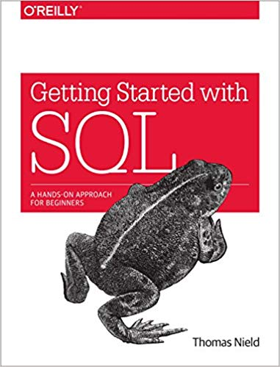


About the Speaker
Thomas Nield
Nield Consulting Group, LLC
Author of Getting Started with SQL by O'Reilly and Learning RxJava by Packt
My other online trainings at O'Reilly:
SQL Fundamentals for Data
Intermediate SQL for Data Analytics
Programming with SQL
Intro to Mathematical Optimization
Machine Learning from Scratch
thomasnield9727
https://github.com/thomasnield

Slide 3
What to Expect
Introduction
Probability Math
Bayes Theorem
Binomial and Beta Distribution
Normal Distribution

Slide 4
Section I
Why Learn Probability?

Slide 5
The Monty Hall Problem

Slide 6




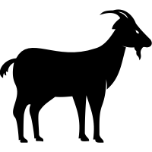


The Monty Hall Problem
DOOR 1
DOOR 2
DOOR 3
Choose a door, one has a prize. Two others have goats.
6

Slide 7


The Monty Hall Problem
DOOR 1
DOOR 2
DOOR 3
You choose Door 1.
What is the probability it has the prize?
7

Slide 8


The Monty Hall Problem
DOOR 1
33.33%
DOOR 2
33.33%
DOOR 3
33.33%
You choose Door 1.
What is the probability it has the prize? 33%
8

Slide 9

The Monty Hall Problem
DOOR 1
DOOR 2
Twist! Door 3 was just opened. It’s a goat.
Did you want to switch from Door 1 to Door 2?
9

Slide 10
The Monty Hall Problem
DOOR 1
?%
DOOR 2
?%
What is the prize probability of each door now?
10

Slide 11

The Monty Hall Problem
DOOR 1
?%
DOOR 2
?%
HINT: The prize probability of either door is not 50%

Slide 12


The Monty Hall Problem
DOOR 1
33.33%
DOOR 2
66.66%
The probability of Door 1 is 33.33% while Door 2 is now 66.66%. You should switch! But why?

Slide 13
The Monty Hall Problem
33.33%
66.66%
33.33%

Slide 14
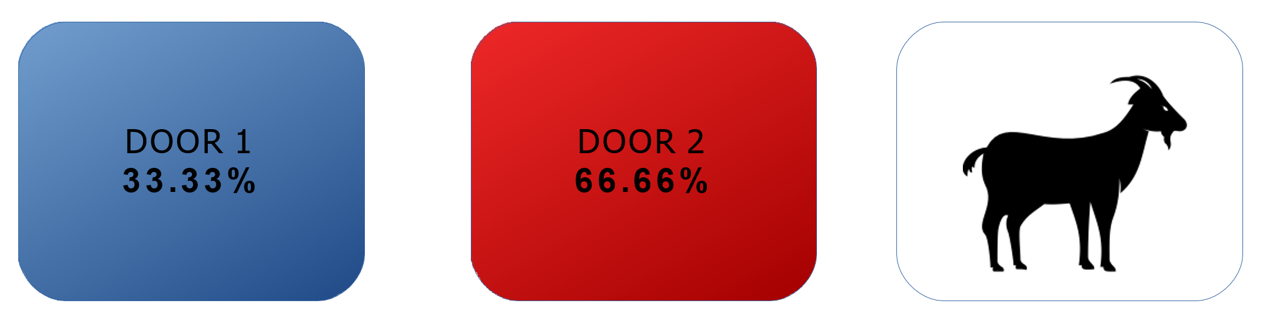
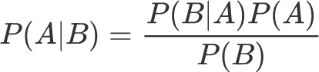
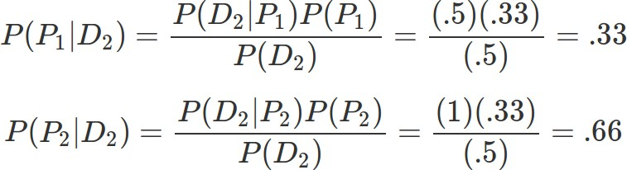
The Monty Hall Problem
According to Bayes Theorem...

Slide 15
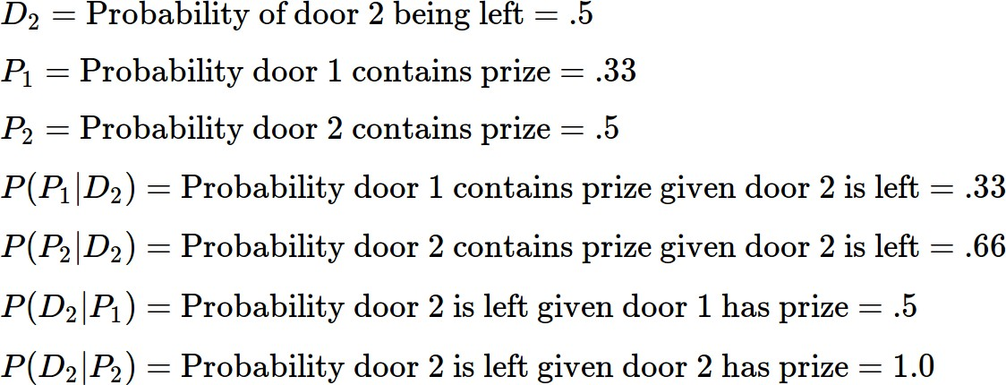
The Monty Hall Problem

Slide 16






































































































































The Monty Hall Problem
Still confused? Hyperbolize! Imagine you had 1000 doors, and you chose Door #19.
19

Slide 17


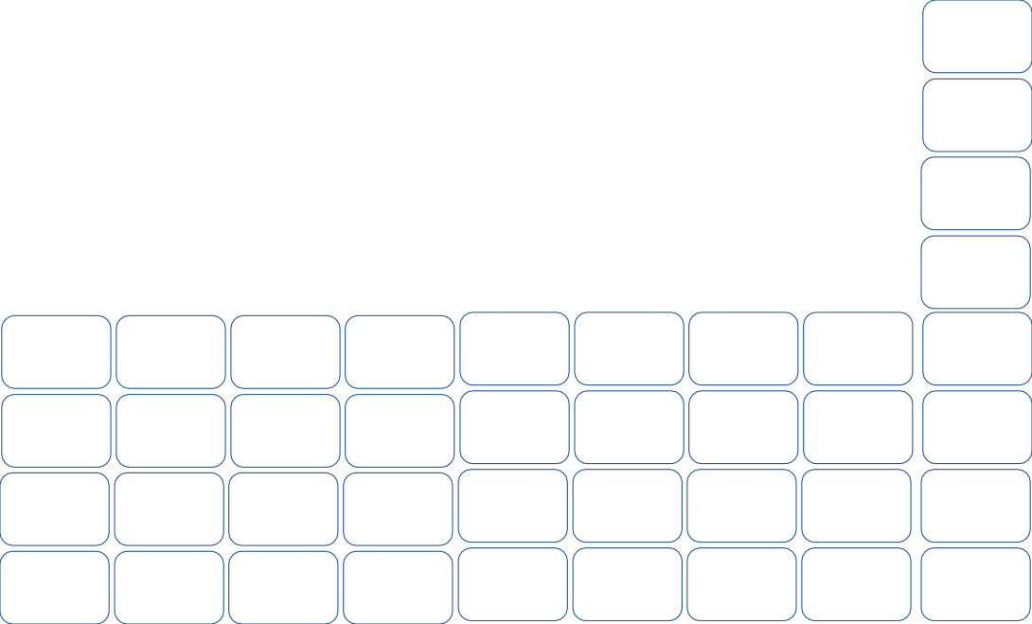



The Monty Hall Problem
All other doors are opened but yours and Door #77. Inclined to switch now?
19
77

Slide 18
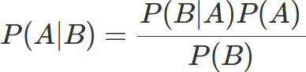

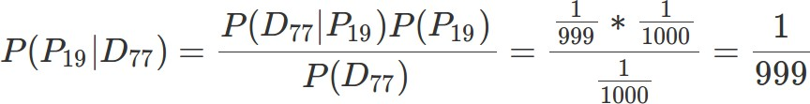
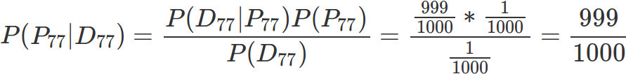


The Monty Hall Problem
#19
#77
Yes, you should switch!

Slide 19
Monte Carlo Simulation
OUTPUT:
STAY WIN RATE: 0.3373, SWITCH WIN RATE: 0.6627
from random import randint def random_door(): return randint(1, 3) trial_count = 10000 stay_wins = 0 switch_wins = 0 for i in range(0, trial_count): prize_door = random_door() selected_door = random_door() opened_door = list(d for d in range(1, 4) if d != selected_door and d != prize_door)[0] switch_door = list(d for d in range(1, 4) if d != selected_door and d != opened_door)[0] if selected_door == prize_door: stay_wins += 1 if switch_door == prize_door: switch_wins += 1 print("STAY WIN RATE: {}, SWITCH WIN RATE: {}".format(float(stay_wins) / float(trial_count), float(switch_wins) / float(trial_count)))

Slide 20
Monte Carlo simulation of the Monty Hall Problem
https://gist.github.com/thomasnield/95443be4d5255929a0d716933df29de7

Slide 21

Why Learn Probability?
Probability is the building block to statistics, machine learning, data science, engineering, and several other disciplines.
It is common to have to make decisions with limited information; as a matter of act, this is the majority of decision we make.
Probability enables us to measure how certain we are in an outcome occurring and while this is an imperfect art, it can be immensely valuable.

Slide 22
Probability versus Statistics
Probability and statistics often get confused and said interchangeably, but there is a distinction.
Probability is solely about studying likelihood.
Statistics utilizes data to discover likelihood.
In practicality, these two things are going to be tightly tied together, as one can argue it is hard to have probability without data.
We will put more emphasis on probability in this class, but we will work with data and statistics where it makes sense.
A normal distribution is a probability tool, but it becomes statistical when it is fit to data points.

Slide 23

What is Probability?
Probability is how likely an event will happen, based on observations or belief.
How likely is it I will get 7 heads in 10 fair coin flips?
What are my chances in winning an election?
What is the likelihood my flight will be late?
How certain am I a product is defective?
Probability is often expressed in two ways:
As a percentage: 60% chance my flight will be late
As an odds ratio: 3:2 odds my flight will be late
However, there are two philosophies on probability.

Slide 24
Frequentist Probability
Frequentist probability is the most popularly understood approach to probability, believing that frequency of an event provides hard evidence of the probability.
EXAMPLE: I flip a coin 10 times and I get 7 heads, so I suspect the probability of heads is 70%.
This definition might be a little simplistic, as frequentists believe gathering more data will increase confidence in the probability.
Frequentism tends to work best when a lot of data is available, reliable, and complete.
Tools frequentists use include p-values and confidence intervals.
7
3
Heads
Tails
Bernoulli distribution of coin flip outcomes

Slide 25
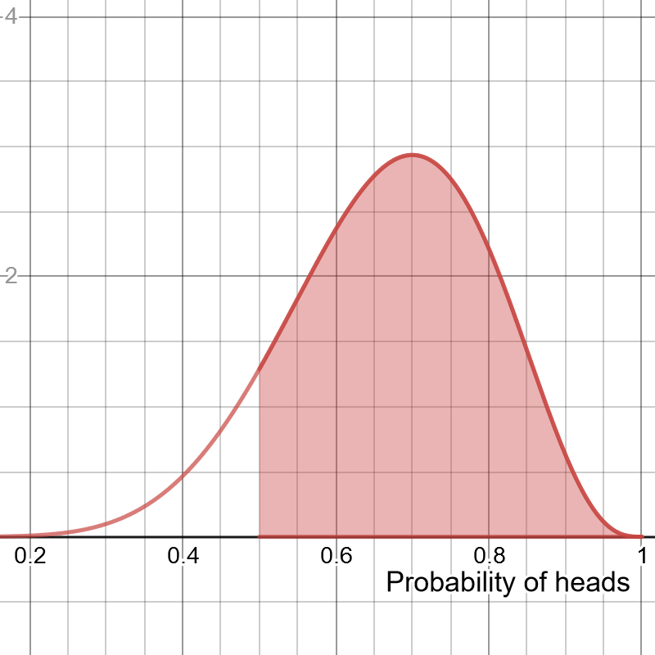
Bayesian Probability
Bayesian probability is much more abstract in that it assigns subjective beliefs in a probability and not just data.
An arbitrary probability can be assigned based on subjective beliefs, and then data can be used to gradually update that belief.
EXAMPLE: I believe a coin has 50% probability of heads. I flip it 10 times and I get 7 heads. I update a beta distribution (to the right) and see there are greater likelihoods of heads being more than 50%.
Bayesian methods tend to work well when data is limited, a large amount of domain knowledge is present, or uncertainty is hard to eliminate.
Bayesian tools include the Bayes factor and credible intervals.
Beta distribution showing the probability of probabilities
of heads, given 7 heads and 3 tails.

Slide 26
Bayes versus Frequentist? Which is right?
Frequentists believe probability is absolute, and Bayesians believe probability is a fuzzy construct.
Which of these philosophies are right? Both!
Some situations warrant Frequentism, while others warrant Bayes.
Frequentism is better if you can converge on a single probability based on enough data, but Bayes is more suited if you want to entertain larger ranges of possibility for a limited amount of data.
Keep in mind that all models are wrong but some are useful, and you should always seek the right tool for the job.
7
3

Slide 27
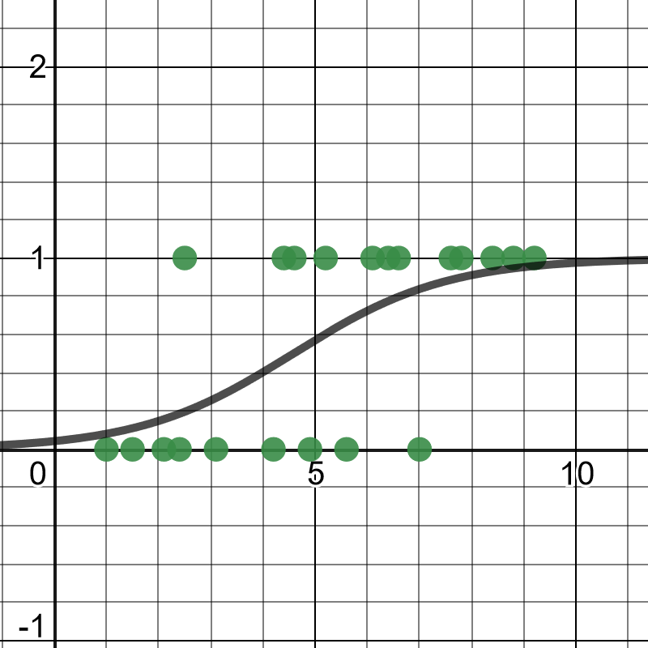
Probability and Machine Learning
While machine learning is not the focus of this class, know that probability is the building block of machine learning!
Machine learning processes data and infers and combines probabilities based on the data.
Probability is used not just for data preparation and analysis but also feature selection, optimization, and prediction.
We will learn how to perform maximum likelihood estimation later to fit a normal distribution to observed data, as well as a logistic regression.
Logistic regression predicts a probability an event will happen given one or more variables and uses maximum likelihood estimation to fit a curve to the data.

Slide 28


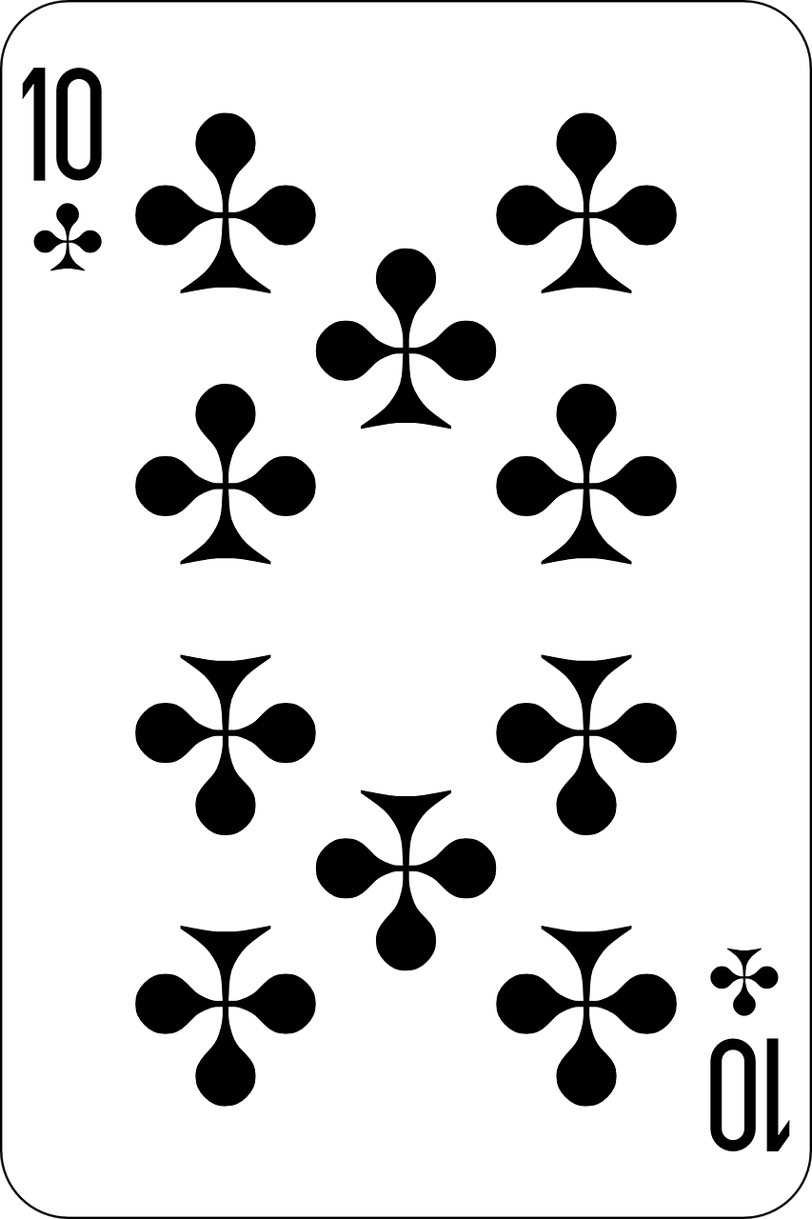
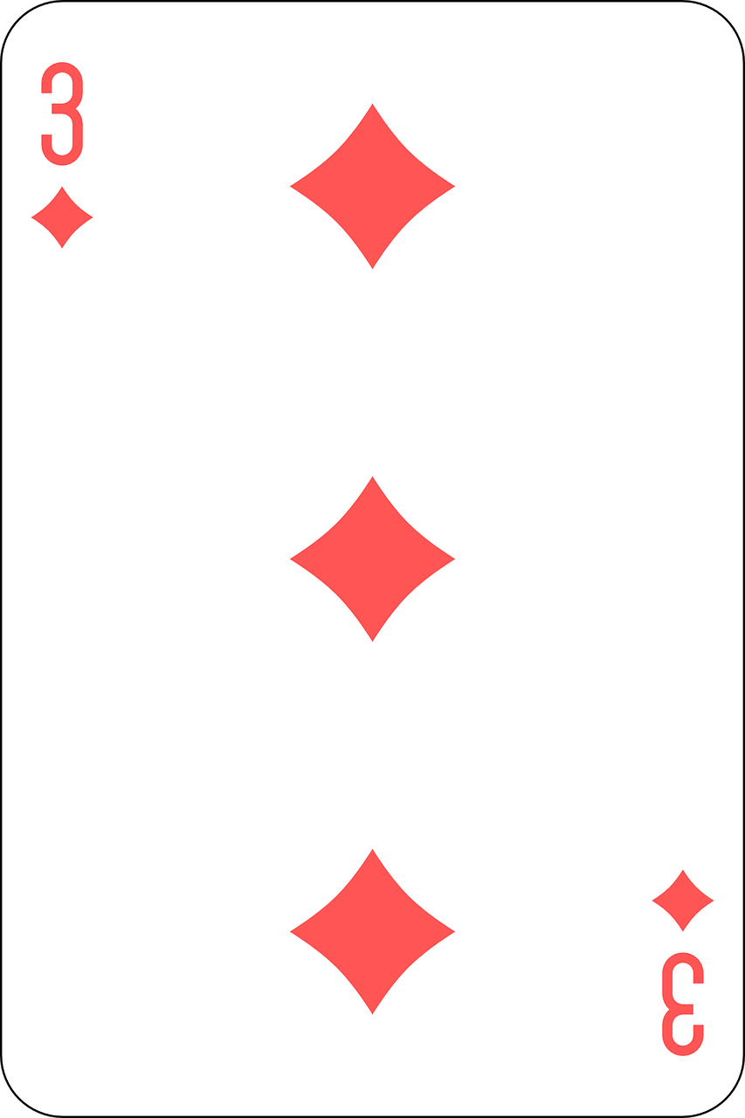
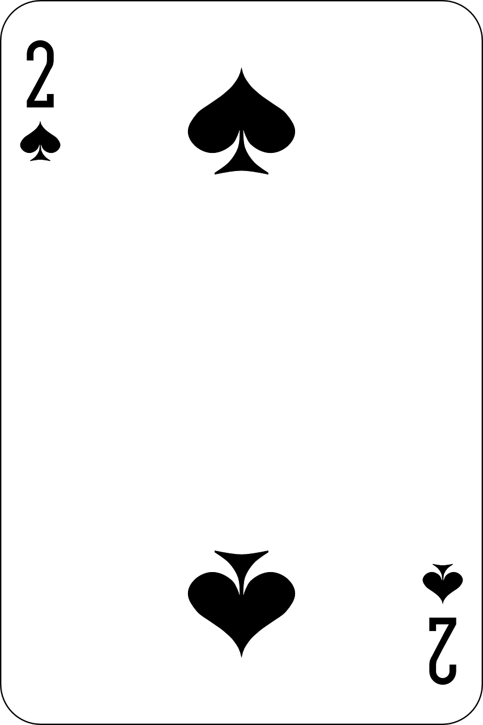

Texas Sharpshooter Fallacy
As you start to work with probability, statistics, and machine learning, one thing to be careful about is to not fall victim to finding patterns in randomness.
Say I drew four cards from a deck:
Is this not fascinating? I have two 10’s and a consecutive 3 and 2! What does it mean?
Should I predict the next four cards will also have two 10’s and two consecutive numbers?
As I start diving into analyzing this outcome, note I never made it my objective to achieve this outcome; I observed it after it occurred.

Slide 29
Texas Sharpshooter Fallacy
Unless I predicted this specific outcome beforehand, there is nothing meaningful I have accomplished nor did I create a predictive model.
This is known as the Texas Sharpshooter Fallacy, where I have collected data without an objective and then analyzed it afterward, believing there to be meaningful patterns rather than consider it happened by random chance.
This is one of the problems with data mining, a practice of analyzing data that was never collected with a specific objective.
As you work with probability, statistics, and machine learning be careful to not fall into this trap of finding meaning in random patterns.

Slide 30
Section II
Probability Fundamentals

Slide 31

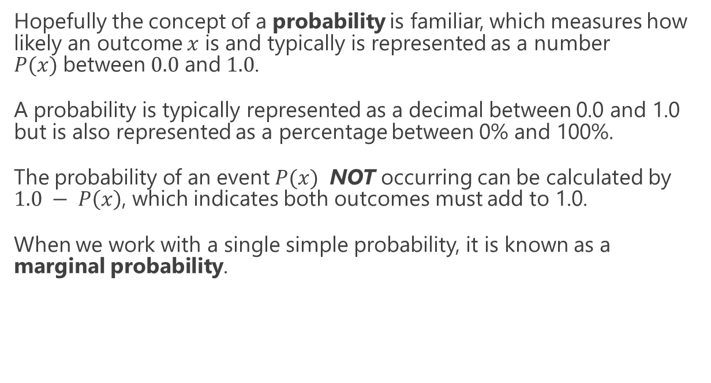
Probability Basics
Hopefully the concept of a probability is familiar, which measures how likely an outcome $x$ is and typically is represented as a number $P(x)$between $0.0$ and $1.0$.
A probability is typically represented as a decimal between 0.0 and 1.0 but is also represented as a percentage between 0% and 100%.
The probability of an event $P(x)$ NOT occurring can be calculated by $1.0 − P\left(x\right)$, which indicates both outcomes must add to 1.0.
When we work with a single simple probability, it is known as a marginal probability.

Slide 32

Where Does Probability Come From?
Probability can be based off data, a belief, or both!
Probability based on data: If we sample 10 products from a factory line and find 4 items are defective, that would be a 40% defective rate.
Probability based on belief: An engineer realizes an inferior material was used and guesses the defective rate for the product will be 50%.
Probability based on data + belief: we can quantify the engineer’s belief and the data, merge them together, and find a 44.44% probability is most likely.

Slide 33
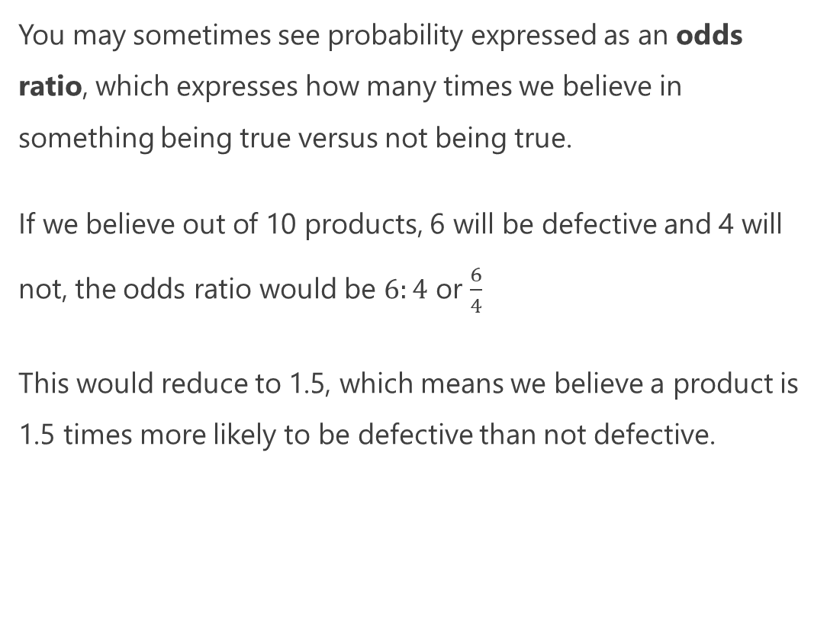
Expressing Probability as Odds
You may sometimes see probability expressed as an odds ratio, which expresses how many times we believe in something being true versus not being true.
If we believe out of 10 products, 6 will be defective and 4 will not, the odds ratio would be $6:4$ or $\frac{6}{4}$
This would reduce to 1.5, which means we believe a product is 1.5 times more likely to be defective than not defective.

Slide 34
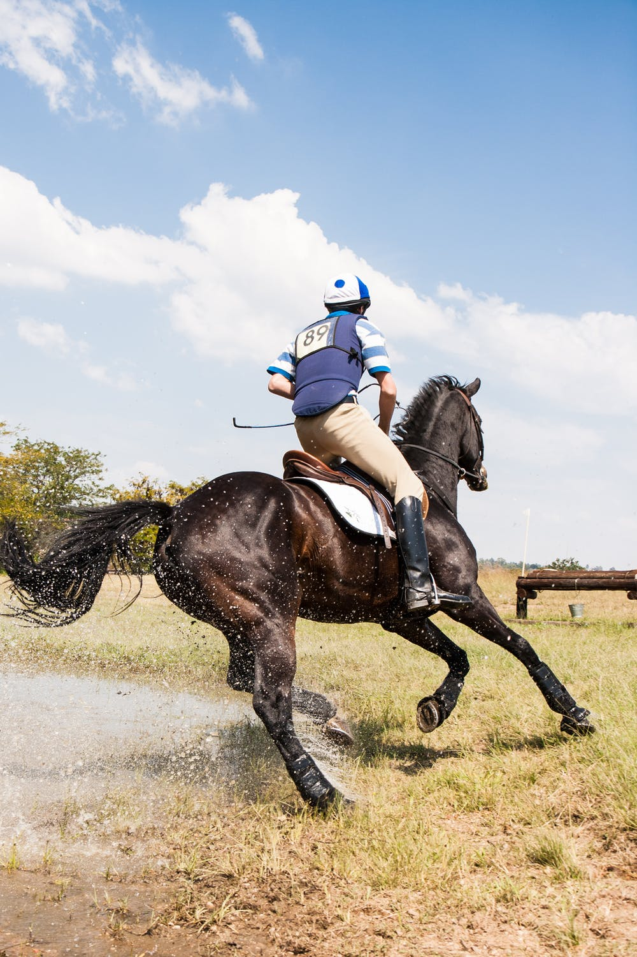
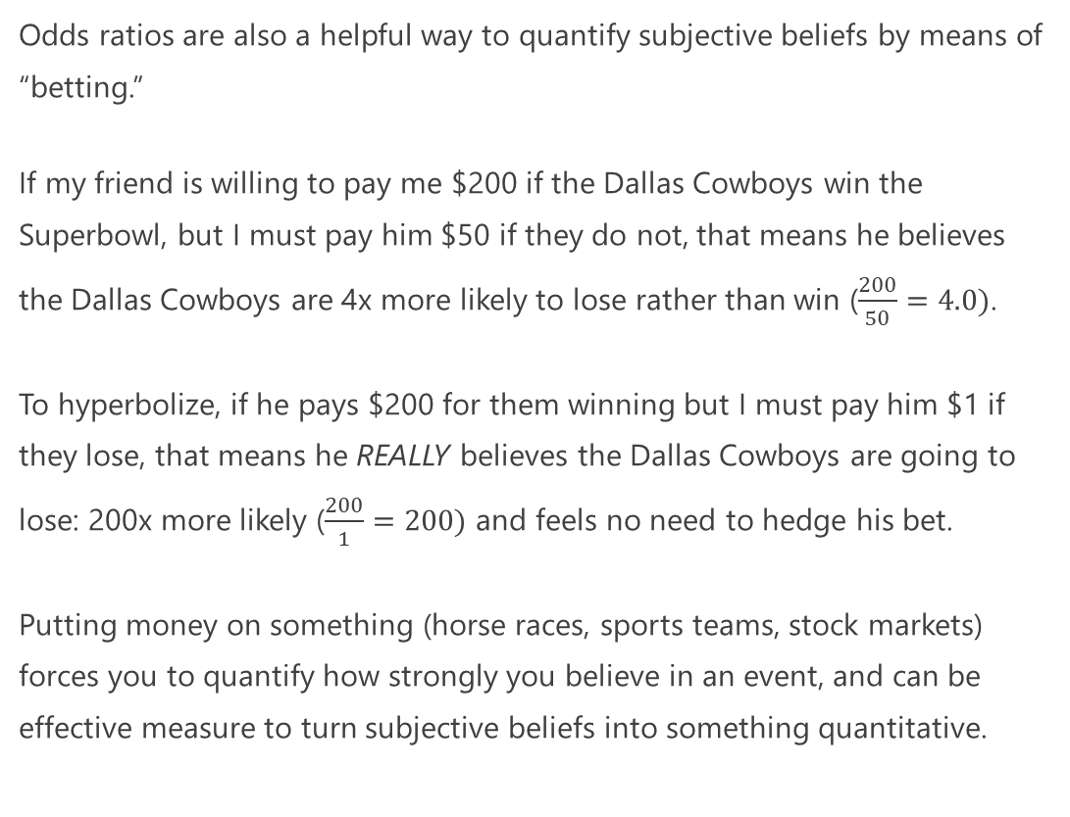
Quantifying Belief with Odds
Odds ratios are also a helpful way to quantify subjective beliefs by means of “betting.”
If my friend is willing to pay me $200 if the Dallas Cowboys win the Superbowl, but I must pay him $50 if they do not, that means he believes the Dallas Cowboys are 4x more likely to lose rather than win ($\frac{200}{50}=4.0)$.
To hyperbolize, if he pays $200 for them winning but I must pay him $1 if they lose, that means he REALLY believes the Dallas Cowboys are going to lose: 200x more likely ($\frac{200}{1}=200)$ and feels no need to hedge his bet.
Putting money on something (horse races, sports teams, stock markets) forces you to quantify how strongly you believe in an event, and can be effective measure to turn subjective beliefs into something quantitative.

Slide 35
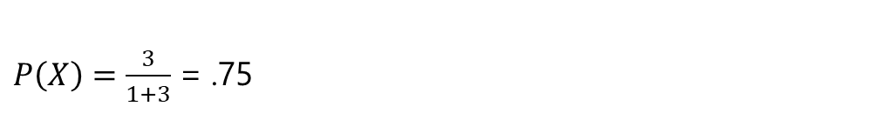
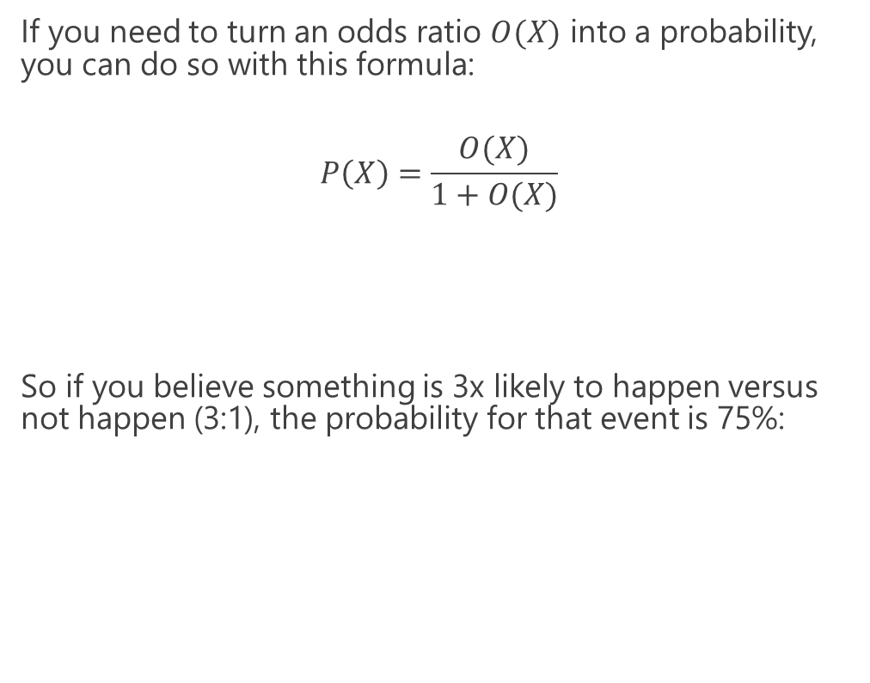
Turning Odds into Probabilities
If you need to turn an odds ratio $O(X)$ into a probability, you can do so with this formula:
$$P\left(X\right)=\frac{O(X)}{1+O(X)}$$
So if you believe something is 3x likely to happen versus not happen (3:1), the probability for that event is 75%:
$P\left(X\right)=\frac{3}{1+3}$ = .75

Slide 36

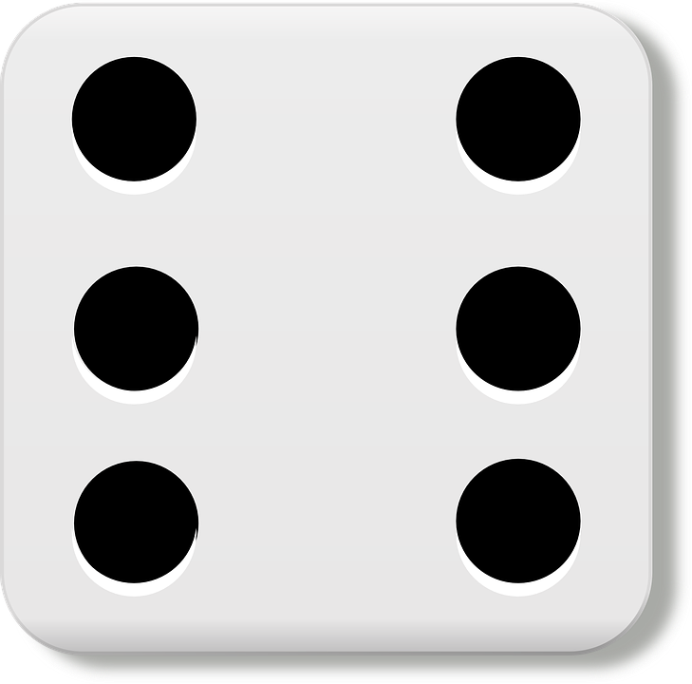
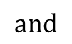
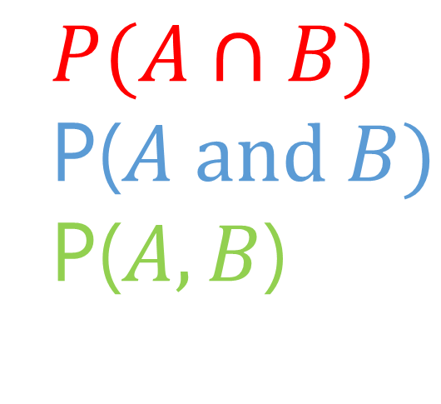
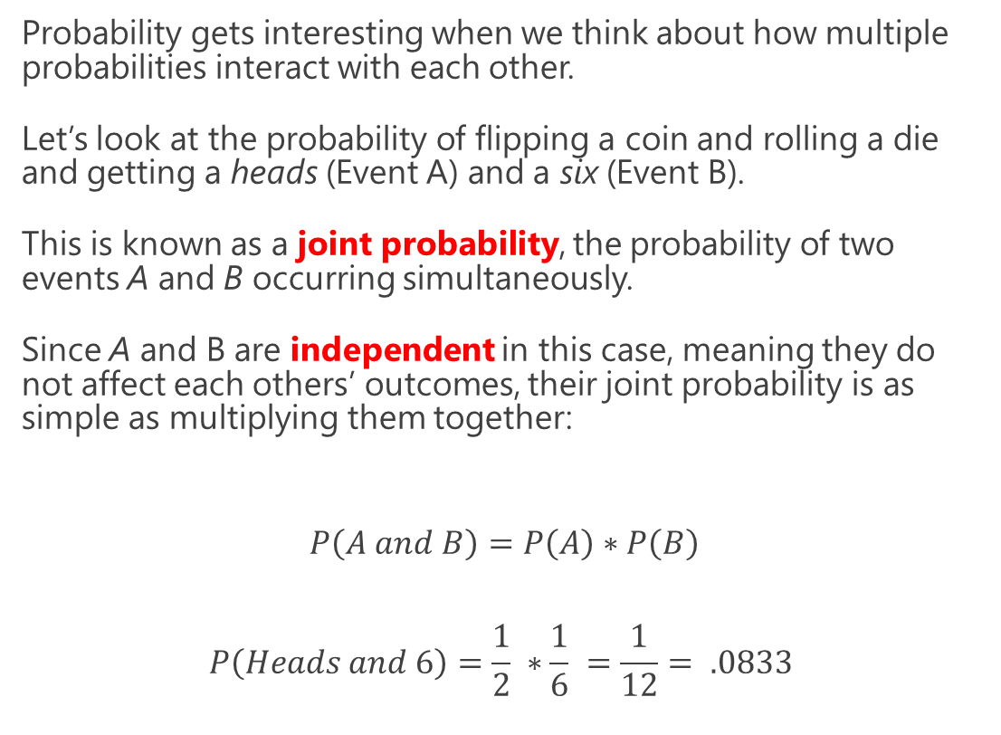
Joint Probabilities
Probability gets interesting when we think about how multiple probabilities interact with each other.
Let’s look at the probability of flipping a coin and rolling a die and getting a heads (Event A) and a six (Event B).
This is known as a joint probability, the probability of two events A and B occurring simultaneously.
Since A and B are independent in this case, meaning they do not affect each others’ outcomes, their joint probability is as simple as multiplying them together:
$$P\left(A and B\right)=P\left(A\right)∗P\left(B\right)$$
$$P\left(Heads and 6\right)=\frac{1}{2} ∗\frac{1}{6} =\frac{1}{12}= .0833$$
$$P(A∩B)$$
P($A and B)$
P($A,B$)
$$and$$

Slide 37
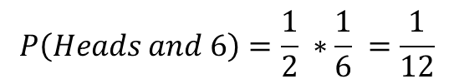
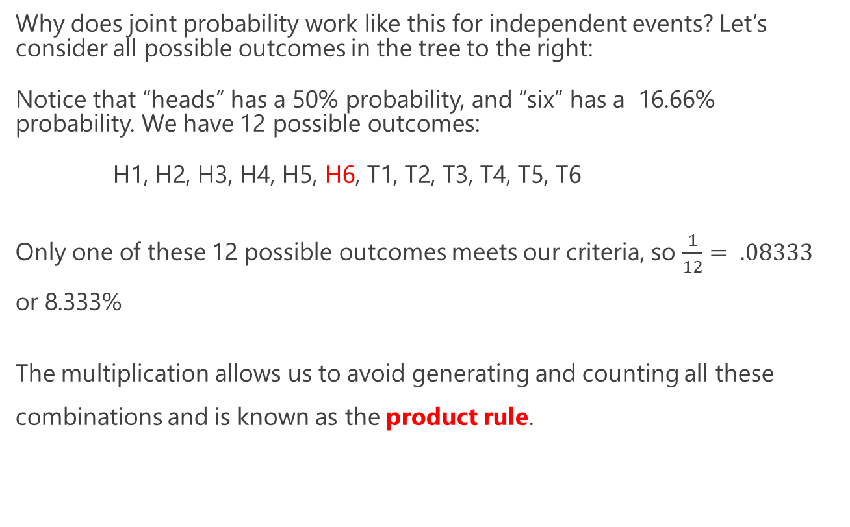
Joint Probabilities
Why does joint probability work like this for independent events? Let’s consider all possible outcomes in the tree to the right:
Notice that “heads” has a 50% probability, and “six” has a 16.66% probability. We have 12 possible outcomes:
H1, H2, H3, H4, H5, H6, T1, T2, T3, T4, T5, T6
Only one of these 12 possible outcomes meets our criteria, so $\frac{1}{12}= .08333$ or 8.333%
The multiplication allows us to avoid generating and counting all these combinations and is known as the product rule.
H
T
1
2
3
4
5
6
1
2
3
4
5
6
$$P\left(Heads and 6\right)=\frac{1}{2} ∗\frac{1}{6} =\frac{1}{12}$$

Slide 38
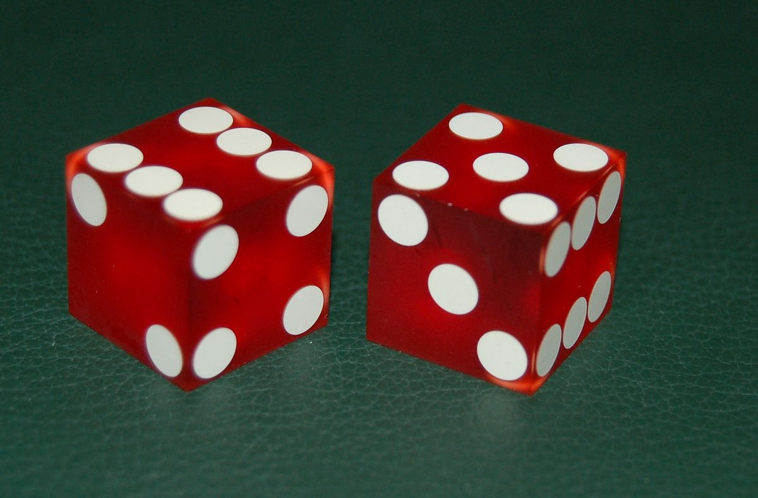
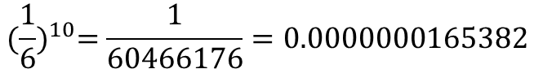
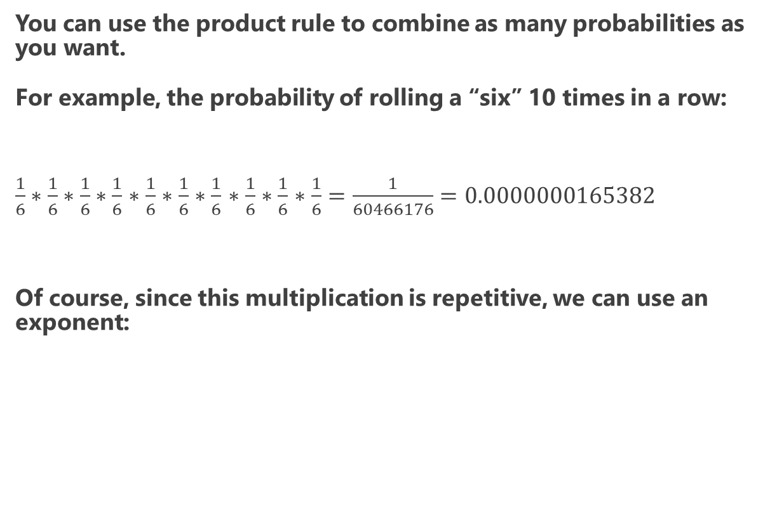
Joint Probabilities
You can use the product rule to combine as many probabilities as you want.
For example, the probability of rolling a “six” 10 times in a row:
$\frac{1}{6}∗\frac{1}{6}∗\frac{1}{6}∗\frac{1}{6}$ $∗\frac{1}{6}$ $∗\frac{1}{6}$ $∗\frac{1}{6}$ $∗\frac{1}{6}$ $∗\frac{1}{6}$ $∗\frac{1}{6}=\frac{1}{60466176}=0.0000000165382$
Of course, since this multiplication is repetitive, we can use an exponent:
$${(\frac{1}{6})}^{10}=\frac{1}{60466176}=0.0000000165382$$

Slide 39
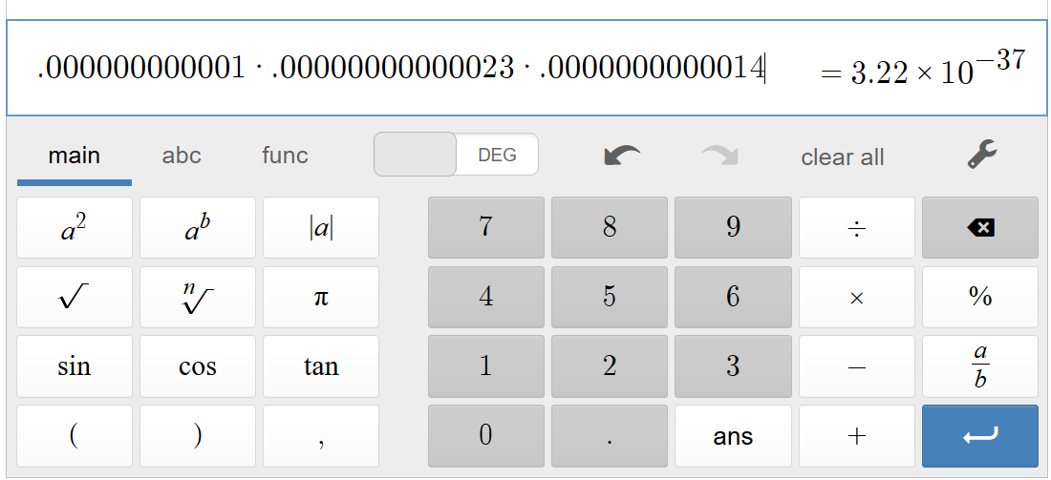
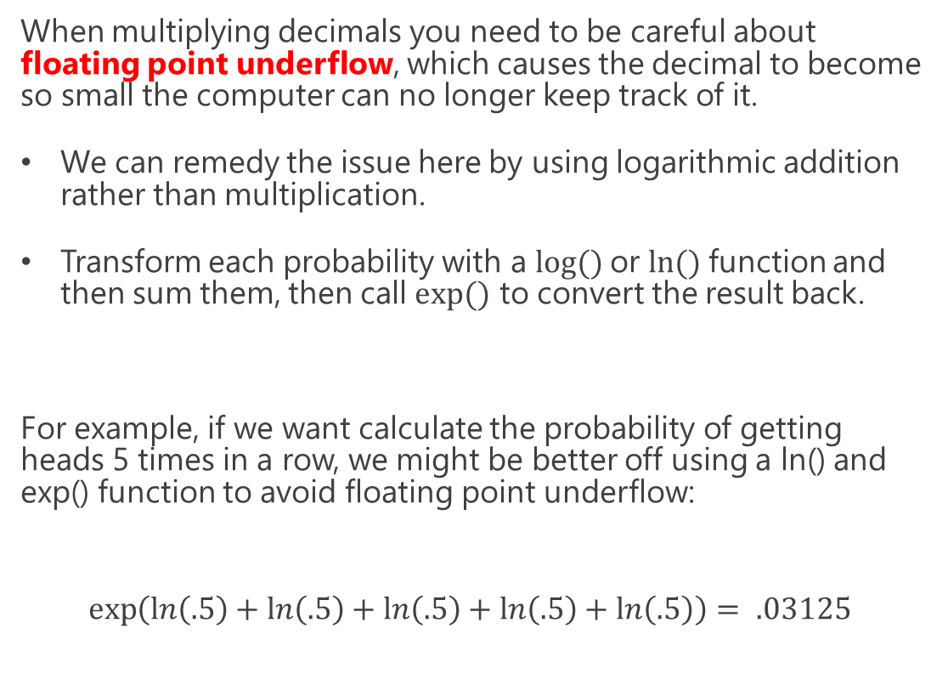
Floating Point Underflow
When multiplying decimals you need to be careful about floating point underflow, which causes the decimal to become so small the computer can no longer keep track of it.
We can remedy the issue here by using logarithmic addition rather than multiplication.
Transform each probability with a $log⁡()$or $ln⁡()$function and then sum them, then call $exp⁡()$ to convert the result back.
For example, if we want calculate the probability of getting heads 5 times in a row, we might be better off using a ln() and exp() function to avoid floating point underflow:
$$\exp\left(\ln\left(.5\right)+\ln\left(.5\right)+\ln\left(.5\right)+\ln\left(.5\right)+\ln\left(.5\right)\right)= .03125$$

Slide 40
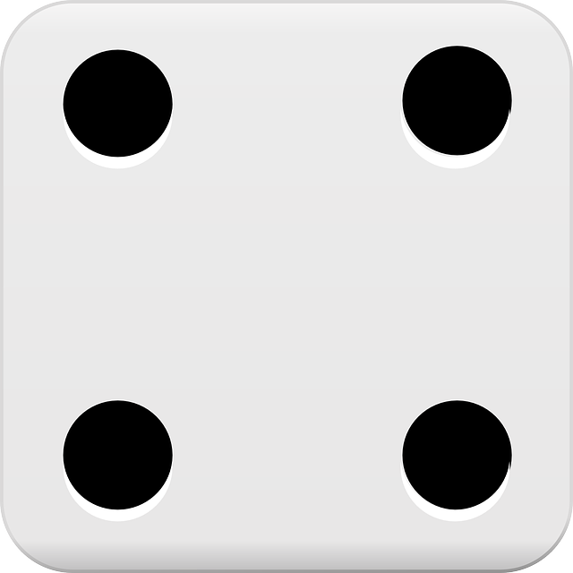
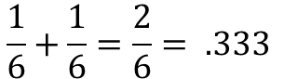
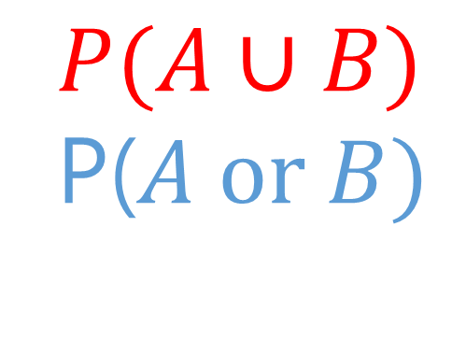
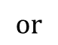
Union Probability – Mutually Exclusive
Things get a little more nuanced when we work with union probabilities, or the probability that at least one of multiple events will occur.
When two events are mutually exclusive, meaning that only one of the events can occur but not both, then it is as easy as adding their probabilities together.
For example, what is the probability of getting a “4” or “6” on a die roll? Since we cannot get “4” and a “6” simultaneously, we just add these probabilities together.
$$P(A∪B)$$
P($A or B)$
$$or$$
$$\frac{1}{6}+\frac{1}{6}=\frac{2}{6}= .333$$

Slide 41
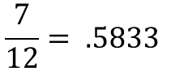
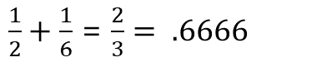
Union Probability – Non-Mutually Exclusive
When two events are non-mutually exclusive, meaning that two events can occur simultaneously, their union probability gets tricky.
What is the probability of getting a “heads” OR a “six” with a coin flip and a die roll? Before we try anything let’s look at the possible outcomes:
H1, H2, H3, H4, H5, H6, T1, T2, T3, T4, T5, T6
The outcomes in red are the ones that meet our condition, and counting them would lead us to a correct answer:
But if we added those two probabilities together, we would get a wrong answer! So why does this not work?
$$P(A∪B)$$
P($A or B)$
$$or$$
$$\frac{7}{12}= .5833$$
$\frac{1}{2}+\frac{1}{6}$ = $\frac{2}{3}= .6666$

Slide 42
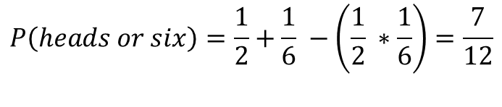
Union Probability – Non-Mutually Exclusive
H1, H2, H3, H4, H5, H6, T1, T2, T3, T4, T5, T6
The problem with adding non-mutually exclusive events is it causes double-counting of joint probability events as highlighted above.
It’s subtle but notice above that if we add the probability of “heads” (1/2) with the probability of getting a “six” (1/6), we have counted that “six” probability of 1/6 twice!
We can remedy this by subtracting the joint probability for non-mutually exclusive events:
This is known as the sum rule, where we can find the OR probability between two or more events by summing them and then subtracting their joint probability.
$$P(A∪B)$$
P($A or B)$
$$or$$
$$P\left(A or B\right)=P\left(A\right)+P\left(B\right)−P\left(A and B\right)$$
$$P\left(heads or six\right)=\frac{1}{2}+\frac{1}{6} −\left(\frac{1}{2} ∗\frac{1}{6}\right)=\frac{7}{12}$$

Slide 43
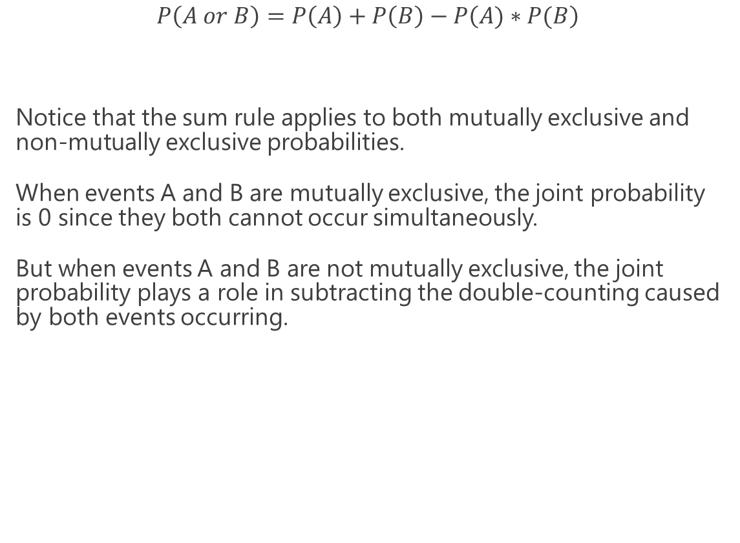
The Sum Rule
$$P\left(A or B\right)=P\left(A\right)+P\left(B\right)−P\left(A)∗P(B\right)$$
Notice that the sum rule applies to both mutually exclusive and non-mutually exclusive probabilities.
When events A and B are mutually exclusive, the joint probability is 0 since they both cannot occur simultaneously.
But when events A and B are not mutually exclusive, the joint probability plays a role in subtracting the double-counting caused by both events occurring.
$$P(A∪B)$$
P($A or B)$
$$or$$

Slide 44
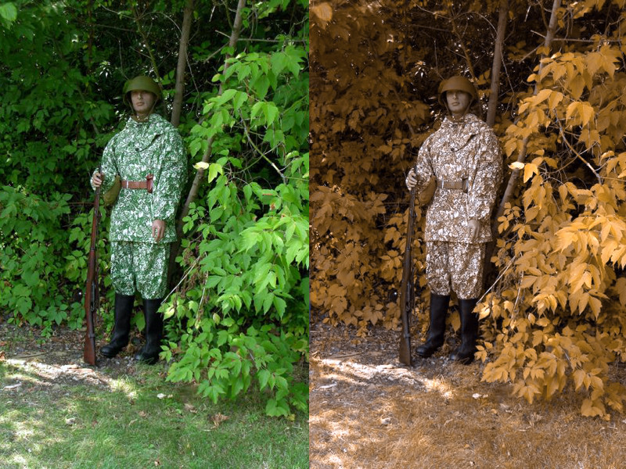
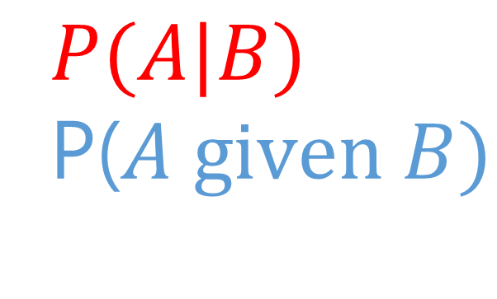
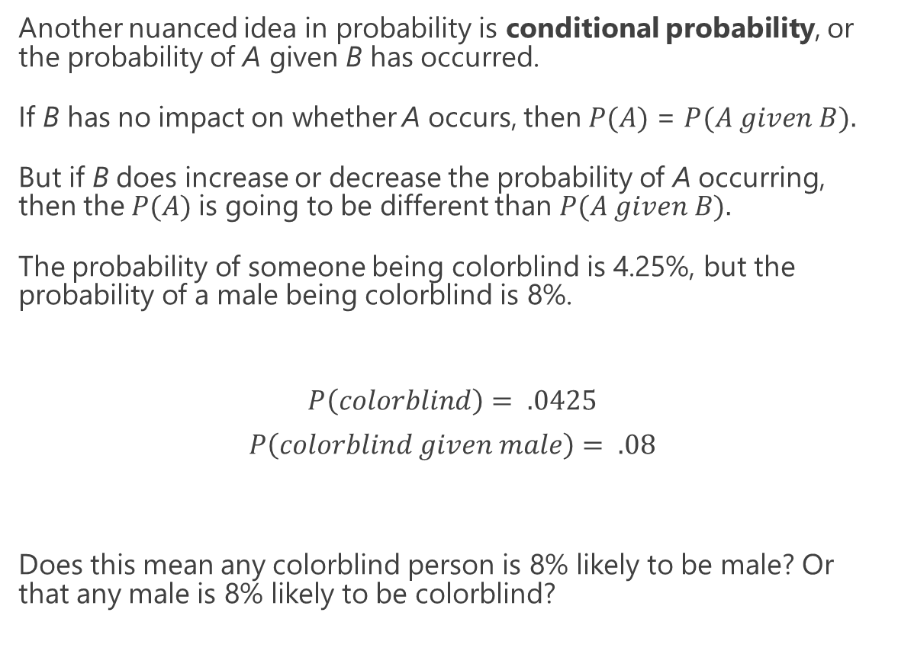
Conditional Probability
Another nuanced idea in probability is conditional probability, or the probability of A given B has occurred.
If B has no impact on whether A occurs, then $P(A)$ = $P(A given B).$
But if B does increase or decrease the probability of A occurring, then the $P(A)$is going to be different than $P(A given B).$
The probability of someone being colorblind is 4.25%, but the probability of a male being colorblind is 8%.
$$P\left(colorblind\right)= .0425$$
$$P\left(colorblind given male\right)= .08$$
Does this mean any colorblind person is 8% likely to be male? Or that any male is 8% likely to be colorblind?
$$P(A|B)$$
P($A given B)$

Slide 45
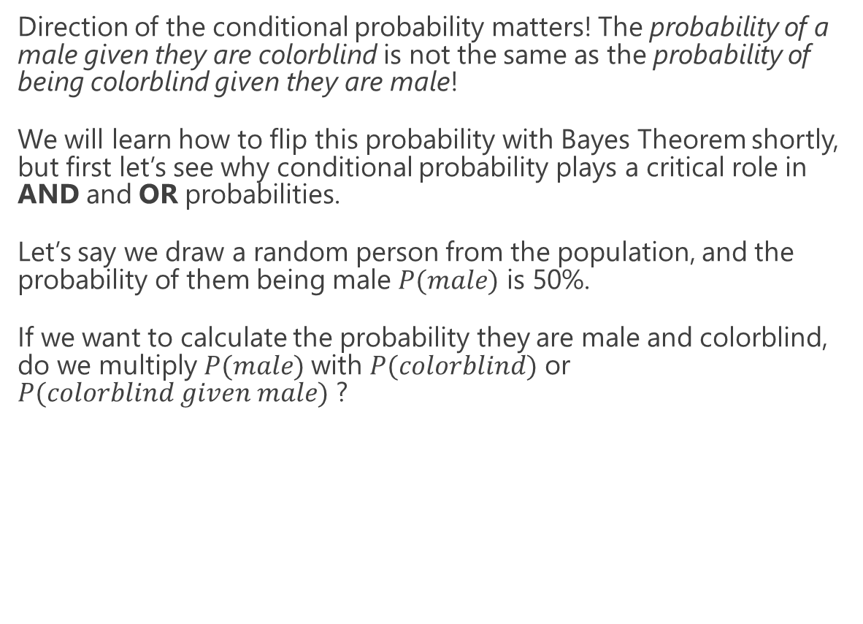
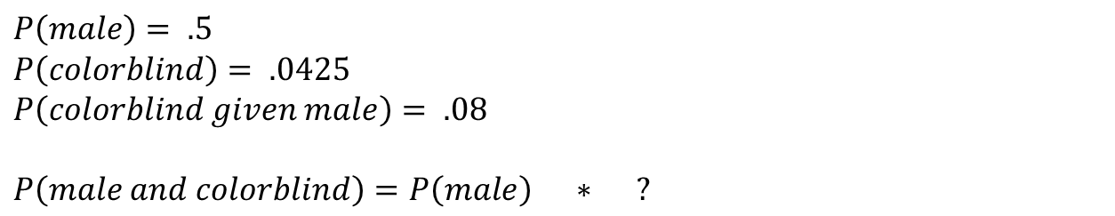
Conditional Probability
Direction of the conditional probability matters! The probability of a male given they are colorblind is not the same as the probability of being colorblind given they are male!
We will learn how to flip this probability with Bayes Theorem shortly, but first let’s see why conditional probability plays a critical role in AND and OR probabilities.
Let’s say we draw a random person from the population, and the probability of them being male $P(male)$ is 50%.
If we want to calculate the probability they are male and colorblind, do we multiply $P(male)$with $P(colorblind)$ or $P(colorblind given male)$ ?
$$P(A|B)$$
P($A given B)$
$$P\left(male\right)= .5$$
$$P\left(colorblind\right)= .0425$$
$$P\left(colorblind given male\right)= .08$$
$$P\left(male and colorblind\right)=P\left(male\right) ∗ ?$$

Slide 46
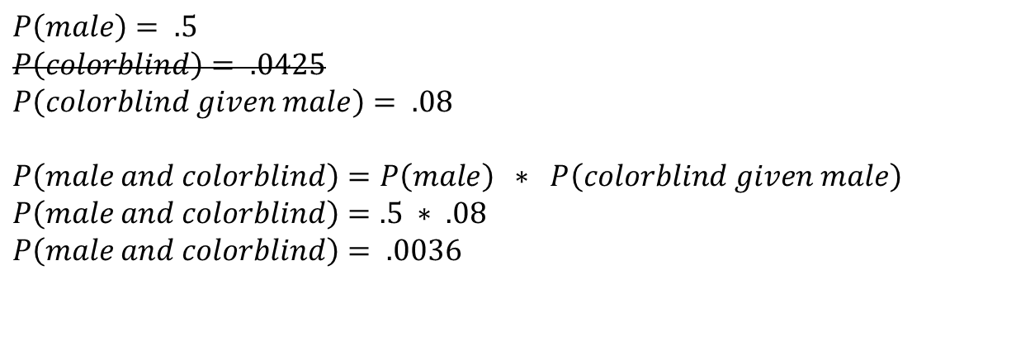
Conditional Probability
$$P\left(male\right)= .5$$
$$P\left(colorblind\right)= .0425$$
$$P\left(colorblind given male\right)= .08$$
$$P\left(male and colorblind\right)=P\left(male\right) ∗ P\left(colorblind given male\right)$$
$$P\left(male and colorblind\right)=.5 ∗ .08$$
$P\left(male and colorblind\right)= .0036$
With joint probability we use the conditional probability when it is available! If we want to calculate the probability of someone being male and colorblind, use the conditional probability that accounts for them being male!
If we do not use the conditional probability, then the probability of them being male and colorblind will be no different than being female and colorblind!
$$P(A|B)$$
P($A given B)$

Slide 47
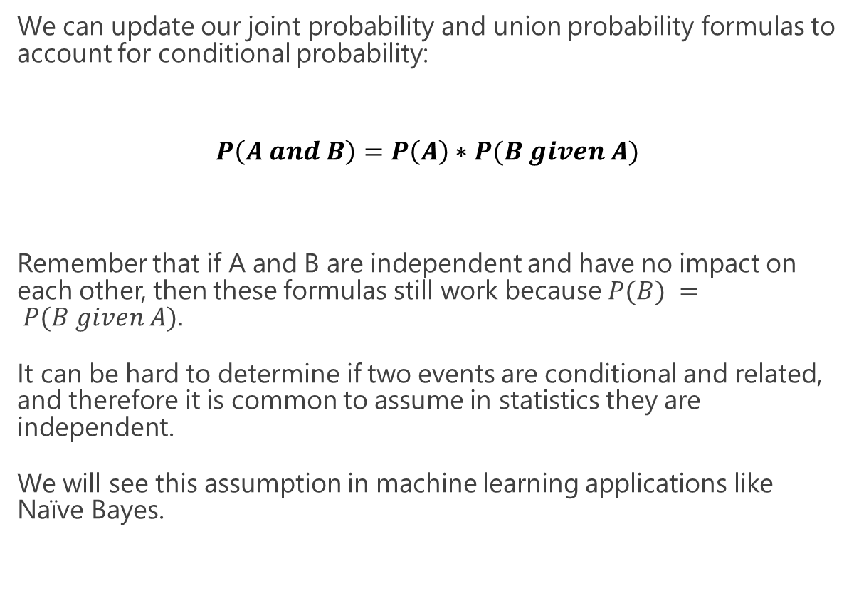
Conditional Probability
We can update our joint probability and union probability formulas to account for conditional probability:
$$P\left(A and B\right)=P\left(A\right)∗P(B given A)$$
Remember that if A and B are independent and have no impact on each other, then these formulas still work because $P(B) = P(B given A).$
It can be hard to determine if two events are conditional and related, and therefore it is common to assume in statistics they are independent.
We will see this assumption in machine learning applications like Naïve Bayes.
$$P\left(A or B\right)=P\left(A\right)+P\left(B\right)−P\left(A\right)∗P(B given A)$$
$$P(A|B)$$
P($A given B)$

Slide 48

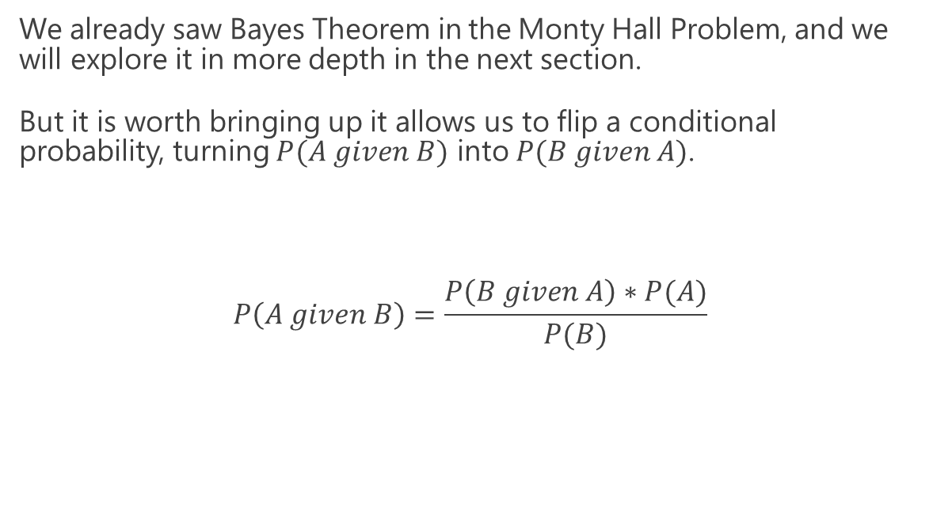
Bayes Theorem
We already saw Bayes Theorem in the Monty Hall Problem, and we will explore it in more depth in the next section.
But it is worth bringing up it allows us to flip a conditional probability, turning $P(A given B)$ into $P(B given A)$.
$$P\left(A given B\right)=\frac{P\left(B given A\right)∗P(A)}{P(B)}$$

Slide 49
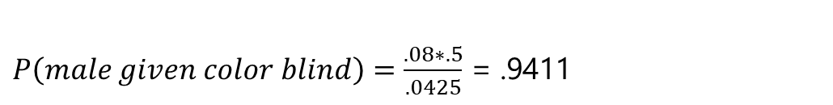
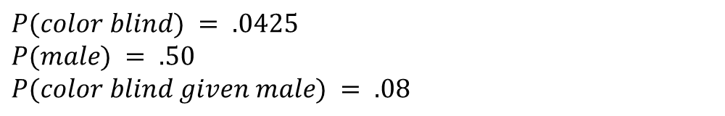

Bayes Theorem
Let’s look at the color blindness problem again. We have these data points:
What is the probability of a person being male given they are color blind?
$$P\left(A given B\right)=\frac{P\left(B given A\right)∗P(A)}{P(B)}$$
$$P(color blind) = .0425$$
$$P(male) = .50$$
$$P(color blind given male) = .08$$
$P\left(male given color blind\right)=\frac{.08∗.5}{.0425}$ = .9411

Slide 50
Bayes Theorem
The probability of a person being male given they are color blind is 94.11%, which is much different than the probability of being color blind given they are a male, which is 8%.
Bayes Theorem is the core of conditional probability, as it allows us to flip inferences based on conditions.
We will learn more about it in the next section.

Slide 51

Exercise 1A
There is a 30% chance of rain today, and a 40% chance your umbrella order will arrive on time. You are eager to walk in the rain today and cannot do so without either!
What is the probability it will rain AND your umbrella will arrive?

Slide 52

Exercise 1A
There is a 30% chance of rain today, and a 40% chance your umbrella order will arrive on time. You are eager to walk in the rain today and cannot do so without either!
What is the probability it will rain AND your umbrella will arrive?
$$P\left(A and B\right)=P\left(A\right)∗P\left(B\right)$$
$$P\left(Rain and umbrella arrives\right)=.30+40= .12$$
12% chance it will rain and your umbrella will arrive.

Slide 53
Exercise 1B
There is a 30% chance of rain today, and a 40% chance your umbrella order will arrive on time.
You will only be able to run errands if it does not rain or your umbrella arrives.
What is the probability it will not rain OR your umbrella arrives?

Slide 54

Exercise 1B
There is a 30% chance of rain today, and a 40% chance your umbrella order will arrive on time.
You will only be able to run errands if it does not rain or your umbrella arrives.
What is the probability it will not rain OR your umbrella arrives?
82% chance it will not rain or your umbrella arrives.
$$P\left(rain\right)= .30$$
$$P\left(no rain\right)=1.0−P\left(rain\right)=1.0 − .30= .70$$
$$P\left(umbrella arrives\right)= .40$$
$$P\left(A or B\right)=P\left(A\right)+P\left(B\right)−P\left(A and B\right)$$
$P\left(no rain or umbrella arrives \right)=.70+ .40 −$ (.70 * .40) = .82

Slide 55
Exercise 1C
There is a 30% chance of rain today, and a 40% chance your umbrella order will arrive on time.
However, you found out if it rains there is only 20% chance your umbrella will arrive on time.
What is the probability it will rain and your umbrella will arrive on time?

Slide 56

Exercise 1C
There is a 30% chance of rain today, and a 40% chance your umbrella order will arrive on time.
However, you found out if it rains there is only 20% chance your umbrella will arrive on time.
What is the probability it will rain and your umbrella will arrive on time?
$$P\left(A and B\right)=P\left(A\right)∗P\left(B given A\right)$$
$$P\left(rain and umbrella arrives\right)=.30 ∗.20= .06$$
6% chance it will rain and your umbrella will arrive.

Slide 57
Section III
Bayes Theorem

Slide 58


Violence and Video Games
Let’s say a study has been released that claims 85% of homicidal criminals in the United States have played violent video games.
What does this mean? Should we be alarmed and blame the video game industry?
Keep in mind that a conditional probability $P\left(\left.A\right|B\right)$ is not the same as its reverse conditional probability $P\left(\left.B\right|A\right)$.
$P\left(\left.gamer\right|homicidal\right)= .85$
$P\left(\left.homicidal\right|gamer\right)= ?$
Just because most homicidal people are gamers (according to this study), does that mean most gamers are homicidal?
The answer we will discover is “NO!”
This Photo is licensed under CC BY

Slide 59


Violence and Video Games
We need to use Bayes Theorem to flip the condition:
But we only have $P\left(\left.gamer\right|homicidal\right)$ which is .85.
We also need $P\left(homicidal\right)$ and $P\left(gamer\right)$ if we are going to flip the direction of the probability.
$$P\left(\left.A\right|B\right)=\frac{P\left(\left.B\right|A\right)∗P\left(A\right)}{P\left(B\right)}$$
$$P\left(\left.homicidial\right|gamer\right)=\frac{P\left(\left.gamer\right|homicidal\right)∗P\left(homicidal\right)}{P\left(gamer\right)}$$
This Photo is licensed under CC BY

Slide 60


Violence and Video Games
Sometimes it can be hard to get these other probabilities, but with population studies a little bit of research might give us some numbers.
According to the FBI, there are 17,251 known homicidal offenders in 2017 and according to Wolfram Alpha there are 324 million people in the United States.
Gathering data from video game industry market research, you estimate that 19% of the population plays violent video games.
$P\left(homicial\right)=\frac{17251}{324000000}$ =.00005
This Photo is licensed under CC BY
$$P\left(gamer\right)=.19$$

Slide 61
Discovering Bayes Theorem
Unlike the media and politicians, we continued doing the math and research and found 19% of the population plays violent video games, and .005% of the population is homicidal.
We can use Bayes Theorem to merge these probabilities together.
P(Homicidal if Gamer) = P(Gamer if Homicidal) * P(Homicidal) / P(Gamer)
P(Homicidal if Gamer) = (.85 * .00005) / .19
P(Homicidal if Gamer) = 0.0002
Wow! So if you take any gamer there is only a .02% chance they are homicidal.
This number is much different than the 85% probability a homicidal criminal is a gamer.
This Photo is licensed under CC BY

Slide 62
Discovering Bayes Theorem
So according to Bayes Theorem, a person who plays violent video games is only .02% likely to be violent compared to a non-gamer who is .005% likely.
This number is much less significant than the 85% statistic, and shows how subtle but drastic the difference is between “What is the probability of A given B?” versus “What is the probability of B given A?”
But the media can spin that saying “gamers are 4x more likely to be homicidal” when in actuality, we are comparing small numbers to small numbers.
In other words, we should not take a common trait (playing video games, liking ice cream) and associate it with an uncommon one (being homicidal).
This Photo is licensed under CC BY

Slide 63



Deriving Bayes Theorem
So why does Bayes Theorem work? Let’s look at why this formula makes sense.
Say we have a population of 100,000 people. Here are the probabilities we started with in our problem:
This means we would have the following numbers of people for each category:
What do you observe with these numbers?
$P\left(homicial\right)=$.00005
$P\left(gamer\right)=$.19
$P\left(\left.gamer\right|homicidal\right)$ = .85
This Photo is licensed under CC BY
Homicidal Criminals: 5
Gamers: 19,000
Gamers who are also criminals: 4.25

Slide 64
Deriving Bayes Theorem
Homicidal Criminals: 5
Gamers: 19,000
Gamers who are also criminals: 4.25
Are you really going to go after those 19,000 gamers even though only 4.25 (4 or 5) of them are homicidal criminals?
Now you can see why discrimination happens so easily based on a common attribute being tied to an uncommon attribute, and this is known as the prosecutor’s fallacy.
This is also why machine learning algorithms can discriminate easily when training datasets are imbalanced or poorly sampled.
This Photo is licensed under CC BY

Slide 65
Visualizing Bayes Theorem (Not to Scale)
Entire Population (100,000)
Plays Violent Video Games
(12,000)
Homicidal
(5)

Slide 66

Deriving Bayes Theorem
We can derive Bayes Theorem by working with an actual population number like 100,000.
Remember we derive any subset of this population by multiplying with its respective probability.
The number of homicidal people that are gamers is the probability of being a gamer given they homicidal multiplied by the homicidal population:
$$\#homicidal gamers =P\left(gamer given homicidal\right)∗P\left(homicidal\right) ∗ 100,000$$
The probability of being homicidal given they are gamer is the number of homicidal gamers divided by the gaming population.
This Photo is licensed under CC BY
$$P\left(homicidal given gamer\right)=\frac{P\left(gamer given homicidal\right)∗P\left(homicidal\right) ∗ 100,000}{P\left(gamer\right)∗100,000}$$

Slide 67

Deriving Bayes Theorem
$$P\left(homicidal given gamer\right)=\frac{P\left(gamer given homicidal\right)∗P\left(homicidal\right) ∗ 100,000}{P\left(gamer\right)∗100,000}$$
Notice we can cancel out the population size 100,000 since it exists in both the numerator and denominator.
Look! Does this look familiar? We now have derived Bayes Theorem!
If you are struggling to see how we got here, think about the different population subsets we just calculated, the proportions of that population, and the Python code we will play with next.
$$P\left(homicidal given gamer\right)=\frac{P\left(gamer given homicidal\right)∗P\left(homicidal\right) }{P\left(gamer\right)}$$
This Photo is licensed under CC BY
$$P\left(A given B\right)=\frac{P\left(B given A\right)∗P\left(A\right)}{P\left(B\right)}$$

Slide 68

Bayes and the Confusion Matrix
A medical technology vendor approaches your organization and says they have an “AI system” that takes a small blood sample, assays several variables, ensembles machine learning algorithms, and predicts a health risk (simply categorized as “AT RISK” or “NOT AT RISK”).
The vendor says that 99% of patients who are at risk will test positive.
Is this significant and credible? Why or why not? What should our next questions be?

Slide 69
Bayes and the Confusion Matrix
There is still some missing information you will have to solicit from the vendor.
We are told that for patients that have health risk, 99% will be identified successfully (sensitivity).
But what if we flip the question? What percentage of those who tested positive have the health risk (precision)?
The vendor goes back to their research team and returns with a confusion matrix of 1000 patients they tested.
They give you an answer: 198 / (198 + 50) = 79.8%

Slide 70
Bayes and the Confusion Matrix
With this confusion matrix, we indeed see 99% of those who are at risk test positive, and that 79.8% of those tested positive are at risk. We found the conditional probability in both directions.
Despite these numbers, you start to feel uncomfortable that you are not using outside data beyond the vendor’s test.
What else can we do to verify the vendor’s claims and testing results?

Slide 71
Bayes and the Confusion Matrix
After some Wikipedia research, you discover something pivotal…
Only 1% of the population is at risk.
This means if you planned on deploying this test to 100K patients, only 1000 are likely at risk.
The vendor advertised a 99% true positive rate. You now wonder: will the vendor’s product single out these 1000 patients? Out of 100K? Without error?

Slide 72
Bayes and the Confusion Matrix
If you feel like something is off because only 1% of the population has the health risk, but 20% of the test patients do, you would be right.
Utilizing Bayes Theorem, we can incorporate this 1% statistic to find the true probability of being at risk if tested positive.
P(At Risk if Positive) = P(Positive if at risk) * P(At risk) / P(Positive)
P(At Risk if Positive) = (.99 * .01) / .248
P(At Risk if Positive) = .0339
3.39% is now the probability of risk given a positive test. How did it drop from 99% to 3.39%?

Slide 73
Bayes and the Confusion Matrix
3.39% is now the probability of risk given a positive test. How did it drop from 99% to 3.39%?
This just shows how easily we can get duped by probabilities that are only high in a specific population like the vendor’s 1000 test patients (remember the homicides and video games example)?
So if this test only has a 3.39% probability of successfully identifying a true positive, we probably should not use it.

Slide 74

Normalization Constant
A helpful tool in conditional probabilities is the normalizing constant, which can give us information we may be missing to use in Bayesian problems.
$$P\left(A\right)=P\left(A | B\right)∗P\left(B\right)+P\left(A | not B\right)∗P(not B)$$
This makes sense because if we have an event B that may conditionally affect event A, should not the true and false cases of B occurring add up to the total probability of A?
Take our umbrella problem from earlier:
There is a 30% chance of rain today, and a 40% chance your umbrella order will arrive on time.
However if it rains there is only 20% chance your order will arrive on time, and to run errands there needs to be NO RAIN or your umbrella arrives.
What is the probability it will NOT rain OR your umbrella arrives?
We do not know the conditional probability when there is no rain, but the formula above can help us algebraically solve for it.

Slide 75

Normalization Constant
There is a 30% chance of rain today, and a 40% chance your umbrella order will arrive on time.
However if it rains there is only 20% chance your order will arrive on time, and to run errands there needs to be NO RAIN or your umbrella arrives.
What is the probability it will NOT rain OR your umbrella arrives?
We can solve for $P(on time|no rain)$algebraically:
$$P\left(A\right)=P\left(A | B\right)∗P\left(B\right)+P\left(A | not B\right)∗P(not B)$$
$$P(on time) = P(on time|rain) ∗ P(rain) + P(on time|no rain) ∗ P(no rain)$$
$$.40 = .20 ∗ .3 + P(on time|no rain) ∗(1.0 − .3)$$
$$P\left(on time | no rain\right)= .486$$
$$P(no rain or on time) = P(no rain) + P(on time) – P(no rain) ∗ P(on time|no rain)$$
$$P(no rain or on time) = .7 + .40 – (.7 ∗ .486) = .7598$$
So there is a 75.98% chance it will not rain or your umbrella arrives on time.

Slide 76
Chaining Conditional Probabilities
One of the cool things about Bayes is you can keep chaining several conditional probabilities together that affect an event of interest, assuming each condition is independent of the other conditions.
If I have an event A, and I want to calculate the probability it will occur given event B and event C have occurred, and I have the necessary conditional probabilities:
In the interest of time, I won’t show the derivation of this formula and all the joint probability work but know this allows us to keep updating our beliefs with new evidence.
This is the foundational idea behind the Naïve Bayes machine learning algorithm.
$$P\left(A | B and C\right)=\frac{P\left(B | A\right)∗P\left(C | A\right)∗P(A)}{P\left(B | A\right)∗P\left(C | A\right)∗P\left(A\right)+P\left(B | not A\right)+P\left(C | not A\right)+P(not A)}$$
Great Article: https://towardsdatascience.com/bayes-rule-applied-75965e4482ff

Slide 77

Exercise 2A
An auto manufacturing company Edison develops slick, cutting edge electric cars.
The founder Elom Nusk revealed an ”AI” diagnostics system that pre-emptively detects worn tires with 95% accuracy, so the driver is notified to replace them.
However at a given time only 5% of tires on the road need to be replaced, and the system is flagging positives 7% of the time.
What is the probability of the system correctly identifying a tire as worn?

Slide 78



Exercise 2A
An auto manufacturing company Edison develops slick, cutting edge electric cars.
The founder Elom Nusk revealed an “AI” diagnostics system that pre-emptively detects worn tires with 95% accuracy, so the driver is notified to replace them.
However at a given time only 5% of tires on the road are worn out and need to be replaced, and the system is flagging positives 7% of the time.
What is the probability of the system correctly identifying a tire as “worn”?
$$P\left(A | B\right)=\frac{P\left(B | A\right)∗P(A)}{P(B)}$$
$$P\left(worn | positive\right)=\frac{P\left(positive | worn\right)∗P(worn)}{P(positive)}$$
$$.6786=\frac{.95 ∗ .05}{.07}$$
67.86% chance the system correctly identifies a worn tire

Slide 79
Exercise 2B
An auto manufacturing company Edison develops slick, cutting edge electric cars.
The founder Elom Nusk revealed an “AI” diagnostics system that pre-emptively detects worn tires with 95% accuracy, so the driver is notified to replace them.
However at a given time only 5% of tires on the road need to be replaced, and the system is flagging positives 7% of the time.
What is the probability of the system falsely identifying a not worn tire as “worn”?

Slide 80

Exercise 2B
An auto manufacturing company Edison develops slick, cutting edge electric cars.
The founder Elom Nusk revealed an “AI” diagnostics system that pre-emptively detects worn tires with 95% accuracy, so the driver is notified to replace them.
However at a given time only 5% of tires on the road are worn out and need to be replaced, and the system is flagging positives 7% of the time.
What is the probability of the system falsely identifying a not worn tire as “worn”?
Find missing variable $P\left(positive | not worn\right)$ with Normalization Constant Formula
$$P\left(A\right)=P\left(A | B\right)∗P\left(B\right)+P\left(A | not B\right)∗P(not B)$$
$$P(positive) = P(positive|worn) ∗ P(worn) + P\left(positive | not worn\right)∗ P(not worn)$$
$$.07 = .95∗ .05 + P\left(positive | not worn\right)∗ (1.0 − .05)$$
$$P\left(positive | not worn\right)= .0237$$
Apply Bayes Theorem
$$P(A|B) = P(B|A) ∗ P(A) / P(B)$$
$$P\left(not worn|positive\right)= .3216P(not worn|positive) = (.0237 ∗ .95) / .07P(not worn |positive) = P(positive|not worn) ∗ P(not worn) / P(positive)$$
32.16% chance a positively tested tire is not worn!

Slide 81
Section IV
Discovering the Binomial and Beta Distribution

Slide 82



Discussion: Measuring Uncertainty
You and an engineer colleague are testing a system to figure out its rate of failure, and you want at least 90% success rate.
Each test is expensive and time-consuming, but you were able to complete 10 tests.
8/10 of the tests succeeded but you are dissatisfied that just 10 tests already yielded two failures, and thus conclude an 80% failure rate.
TEST OUTCOME:
This Photo is licensed under CC BY-SA

Slide 83


Discussion: Measuring Uncertainty
You propose going back to the drawing board, but the engineer wants to run more tests arguing this could be a fluke. The only way we will know for sure is to run more tests.
He argues “what if more tests might yield 90% or greater success? Consider the possible scenario below:”
POSSIBLE FUTURE TEST OUTCOME:
This Photo is licensed under CC BY-SA

Slide 84
Discussion: Measuring Uncertainty
You really do not want to do more tests, but you consider the engineer’s argument. After all, if you flip a coin 10 times and get 8 heads, it does not mean the coin is fixed at 80%.
DISCUSSION
Is the success rate really 80%?
How do we determine whether 10 tests are enough to discover the underlying probability of success?
If the true success rate is 90% or more, could we see 8 out of 10 successes by chance?
Why or why not?
This Photo is licensed under CC BY-SA

Slide 85
Discussion: Measuring Uncertainty
Getting more data is always helpful, but sometimes expense and availability prevents us from doing so.
In situations where data is limited, a Bayesian approach can be advantageous over a Frequentist one.
Think about the probabilities of probabilities… if an event inherently has a 90% probability of occurring, what is the likelihood I would get 8/10 successes?
This Photo is licensed under CC BY-SA

Slide 86

The Binomial Distribution
Let’s first consider the binomial distribution to the right, which shows the y likelihood of x successes when the probability of success is 90% and there are 10 trials.
Each bar represents the probability of getting x successes.
If the probability of success is 90%, there is a 19.37% probability I will get 8 successes out of 10 trials.
Notice that all the outcomes add up to 1.0, or 100%, so this is a probability distribution.

Slide 87

The Binomial Distribution
How would I calculate the probability of 8 or less successes?
Sum the probabilities (the bars in red) and you will find the probability of 8 or less successes to be 26.39%
If we are interested in having 90% or greater success, then the probability of seeing less than 90% success is 26.39% EVEN IF each outcome has a 90% success rate.

Slide 88
Binomial Distribution from Scratch in Python
# Factorials multiply consecutive descending integers down to 1 # EXAMPLE: 5! = 5 * 4 * 3 * 2 * 1 def factorial(n: int): f = 1 for i in range(n): f *= (i + 1) return f # Generates the coefficient needed for the binomial distribution def binomial_coefficient(n: int, k: int): return factorial(n) / (factorial(k) * factorial(n - k)) # Binomial distribution calculates the probability of k events out of n trials # given the p probability of k occurring def binomial_distribution(n: int, k: int, p: float): return binomial_coefficient(n, k) * (p ** k) * (1.0 - p) ** (n - k)
p = .9 n = 10 prob_eight_or_less_successes = 0.0 for k in range(0,9): prob_of_k_successes = binomial_distribution(n, k, p) print("PROB {} SUCCESSES: {}".format(k, prob_of_k_successes)) prob_eight_or_less_successes += prob_of_k_successes print("PROB 8 OR LESS SUCCESSES: {}".format(prob_eight_or_less_successes))

Slide 89
The Binomial Distribution
So there is a 26.39% chance the engineer is correct, ASSUMING each success has a 90% success rate.
This is informative showing it’s 26.39% possible to see 8 or less successes with an underlying 90% probability.
But notice that our model ASSUMED the probability of success is 90%. What if we flipped the question and explored other probabilities besides 90%, and how likely each would produce 8/10 successes?

Slide 90

The Beta Distribution
Here’s another way to look at this: consider all underlying rates of success and how likely each is to produce 8/10 successes.
This is the beta distribution, which allows us to see the probabilities of probabilities given so many successes and failures.
To the right shows the range of likelihoods for each actual rate of success, when 10 trials yields 8 successes.
The beta distribution accepts two arguments, the alpha which is the number of successes, and the beta which is the number of failures.
https://www.desmos.com/calculator/zyranflxo4

Slide 91

The Beta Distribution
Given 8/10 successes, the probability that the underlying rate of success is 90% or higher is 22.5%.
https://www.desmos.com/calculator/cakj42wlie

Slide 92

The Beta Distribution
Given 8/10 successes, the probability that the underlying rate of success is 90% or higher is 22.5%.
But the probability of the underlying rate being less than 90% is 77.5%.
https://www.desmos.com/calculator/cakj42wlie

Slide 93

The Beta Distribution
Given 8/10 successes, the probability that the underlying rate of success is 90% or higher is 22.5%.
But the probability of the underlying rate being less than 90% is 77.5%.
Given these numbers, is it worth doing more tests?
https://www.desmos.com/calculator/cakj42wlie

Slide 94
The Beta Distribution
What we essentially have found is there is a 77.5% chance the underlying success rate is below the required threshold of 90%.
https://www.desmos.com/calculator/cakj42wlie

Slide 95

The Beta Distribution
What we essentially have found is there is a 77.5% chance the underlying success rate is below the required threshold of 90%.
But if we want to gamble on that other 22.5% and order a few more tests to confirm, we can make that call too.
https://www.desmos.com/calculator/cakj42wlie

Slide 96
The Beta Distribution
What we essentially have found is there is a 77.5% chance the underlying success rate is below the required threshold of 90%.
But if we want to gamble on that other 22.5% and order a few more tests to confirm, we can make that call too.
But it may be a risk! Judging just by the numbers, we may just want to abandon testing because there’s a 77.5% chance the test truly failed to meet the 90% success rate.
https://www.desmos.com/calculator/cakj42wlie

Slide 97

Using Beta Distribution to Update Predictions
Let’s say our CFO granted funding for 26 more tests and wanted to take that risk.
Accumulating on top of the 8 successes and 2 failures, we now have 30 successes and 6 failures.
Notice our beta distribution got a lot narrower, giving us a stronger credible interval.
The probability of the underlying success rate being less than 90% is now 86.8%, leaving only 14.2% possibility that our system meets requirements.
At this point, it may be time to abandon testing and go back to the drawing board, unless you want to continue gambling on that 14.2%!
https://www.desmos.com/calculator/xnpjwqclnc

Slide 98

Using Beta Distribution to Update Predictions
This shows how versatile the Beta distribution is in updating predictions based on new data.
When we get more trials and get more successes/failures, the beta distribution will start to narrow more confidently on a smaller range.
You can even use the beta distribution to quantify subjective beliefs (using the gambling odds exercise we did earlier) and then merge predictions with different beliefs and data.
Starting the beta distribution without any prior data or beliefs is controversial, but you can start with an alpha=1, beta=1 initialization which has a neutral flat line that is easily overridden by new data.
https://www.desmos.com/calculator/iji1abdcov

Slide 99

Integrating Functions
Before we implement the beta distribution from scratch in Python, let’s first talk about integration, or finding the areas under a curve.
The binomial distribution was easy to integrate, as each probability was on a discrete value and we can just sum them.
But continuous distributions are a different animal, as they are not discrete but rather one continuous, curvy line with infinitely many values.
The x-axis and y-axis are both decimals, and the y-axis does not represent probabilities but rather “density” of likelihood.
To find a probability, we use the area under the curve for a range of x-values.

Slide 100

Integrating Functions
Imagine we packed 6 rectangles under the curve area we are interested in, where the midpoint of each rectangle touches the curve.
Finding the area of a rectangle is easy (area = length * width), and we can sum the areas of these rectangles to give an approximation of the area under the curve.
If we packed 1000 smaller rectangles we would get an even more precise approximation.
An approximation is not a bad thing since computers have to approximate with limited memory and computation anyway.

Slide 101

Integrating Functions in Python
Here is a simple function in Python that will find the area under any function curve f for a range between a and b, with a number of rectangles n.
It works by packing the range with rectangles that extend their midpoint to touch the function curve, and the more rectangles you use the more precise it will be (with a diminishing return).
You can then find the area for ANY Python function that returns a number.
def approximate_integral(a, b, n, f): delta_x = (b - a) / n total_sum = 0 for i in range(1, n + 1): midpoint = 0.5 * (2 * a + delta_x * (2 * i - 1)) total_sum += f(midpoint) return total_sum * delta_x
def my_function(x): return 2 * x area = approximate_integral(a=0, b=1, n=5, f=my_function) print(area)

Slide 102
Integrating the Beta Distribution
We can use the integration function to find the area under our Beta distribution curve for a given range.
When we create a function for a probability distribution that integrates a given range of values.
To the right shows an integration with 6 rectangles to calculate the probability our underlying rate of success is between 90% and 100%.
Of course, we should probably use 1000 rectangles or more to have adequate precision.

Slide 103
Beta Distribution from Scratch in Python
# Factorials multiply consecutive descending integers down to 1 # EXAMPLE: 5! = 5 * 4 * 3 * 2 * 1 def factorial(n: int): f = 1 for i in range(n): f *= (i + 1) return f def approximate_integral(a, b, n, f): delta_x = (b - a) / n total_sum = 0 for i in range(1, n + 1): midpoint = 0.5 * (2 * a + delta_x * (2 * i - 1)) total_sum += f(midpoint) return total_sum * delta_x def beta_distribution(x: float, alpha: float, beta: float) -> float: if x < 0.0 or x > 1.0: raise ValueError("x must be between 0.0 and 1.0") numerator = x ** (alpha - 1.0) * (1.0 - x) ** (beta - 1.0) denominator = (1.0 * factorial(alpha - 1) * factorial(beta - 1)) / (1.0 * factorial(alpha + beta - 1)) return numerator / denominator
greater_than_90 = approximate_integral(a=.90,b=1.0, n=1000, f=lambda x: beta_distribution(x, 8, 2)) less_than_90 = 1.0 - greater_than_90 print("GREATER THAN 90%: {}, LESS THAN 90%: {}".format(greater_than_90, less_than_90))

Slide 104

Exercise 3A
You flipped a coin 19 times and got heads 15 times and tails 4 times.
Do you think this coin has any good probability of being fair?

Slide 105

Exercise 3A
You flipped a coin 19 times and got heads 15 times and tails 4 times.
Do you think this coin has any good probability of being fair?
Considering 99.62% of the density is above 50%, this coin is highly unlikely to be fair.
greater_than_50 = approximate_integral(a=.5,b=1.0, n=1000, f=lambda x: beta_distribution(x, 15, 4)) print(“GREATER THAN 50%: {}".format(greater_than_50))

Slide 106

Exercise 3B
You have 137 passengers booked on a flight from Las Vegas to Dallas.
However it is Las Vegas on a Sunday morning and you estimate each passenger is 40% likely to not show up.
You are trying to figure out how many seats to overbook so the plane does not fly empty.
What is the most likely number of passengers to not show up?
This Photo is licensed under CC BY-NC-ND

Slide 107

Exercise 3B
You have 137 passengers booked on a flight from Las Vegas to Dallas.
However, it is Las Vegas on a Sunday morning and you estimate each passenger is 40% likely to not show up.
You are trying to figure out how many seats to overbook so the plane does not fly empty.
How likely is it 50 or more passengers will not show up?
Probability of having 50 or more passengers not show up is 82.2%
prom binomial_beta import binomial_distribution
p = .4
n = 137
prob_50_or_more_no_shows = 0.0
for k in range(50, 138):
prob_of_k_successes = binomial_distribution(n, k, p)
prob_50_or_more_no_shows + prob_of_k_successes
print(“PROB 50 OR MORE NO-SHOWS: “.format(prob_50_or_more_no_shows))

Slide 108
Exercise 3D
You have 137 passengers booked on a flight from Las Vegas to Dallas.
However, it is Las Vegas on a Sunday morning and you estimate each passenger is 40% likely to not show up.
You are trying to figure out how many seats to overbook so the plane does not fly empty.
What is the most likely number of passengers to not show up?
If you want to use SciPy and Plotly to generate chart to the right:
import numpy as np import pandas as pd import plotly.express as px from scipy.stats import binom, beta df = pd.DataFrame({"# successes" : np.linspace(0,137,138), "likelihood" : np.array([binom.pmf(x, 137, .40) for x in np.linspace(0,137,138)])} ) fig = px.bar(df, x="# successes", y="likelihood") fig.show()

Slide 109
Section V
Discovering the Normal Distribution

Slide 110


Discovering the Normal Distribution
Below is a number line showing recorded weights (in pounds) for 50 adult golden retrievers.
What do you notice about this data?

Slide 111
Discovering the Normal Distribution
Notice that towards the “center” there are more points clustered together, while the “tails” on either end have less points.
We can infer that we are more likely to see more golden retrievers in the 61-67 lb range as opposed to lower or higher weights like 57 and 71.

Slide 112
Discovering the Normal Distribution
Is there a better way we can visualize this data? And get an idea where we would see more golden retrievers in terms of their weight?

Slide 113

Discovering the Normal Distribution
We can try to bin up points on equally-sized ranges, and then count the number of instances as a bar chart to create a histogram.
Unfortunately, we don’t have an infinite amount of data so making the bin ranges too small will not reveal much about the underlying distribution.

Slide 114

Discovering the Normal Distribution
But if we make the bin sizes just right, we might be able to see a shape resembling a probability distribution.
There are many types of distributions, but in this case we can see a nice bell curve known as the normal distribution, also called the Gaussian Distribution.

Slide 115

Discovering the Normal Distribution
We can fit this curve onto a histogram to make inferences about the entire population, as it’s unlikely I will be able to weigh every golden retriever in existence.
There are ways to measure uncertainty whether a bell curve resembles the population’s bell curve, but we will steer clear of statistics in this course.
https://www.desmos.com/calculator/yftpag0tse

Slide 116

Discovering the Normal Distribution
The normal distribution has several important properties that make it useful:
Symmetrical
Most mass is at the center around the mean
Has a spread (being narrow or wide) that is specified by standard deviation.
The “tails” are the least likely outcomes, and approach zero infinitely but never touch zero.
It resembles a lot of phenomena in nature and daily life, and even generalizes non-normal problems because of the central limit theorem.
We can expect any golden retriever to have a weight most likely around 64.43 (the mean), but highly unlikely around 55 or 73.
https://www.desmos.com/calculator/yftpag0tse

Slide 117


The Normal Distribution Formula
$$μ=mean$$
$$σ=standard deviation$$
$$x=observed value$$
$$f\left(x\right)=probability density function$$
Python function:
# normal distribution, returns likelihood def normal_pdf(x: float, mean: float, std_dev: float) -> float: return (1.0 / (2.0 * math.pi * std_dev ** 2) ** 0.5) * math.exp(-1.0 * ((x - mean) ** 2 / (2.0 * std_dev ** 2)))

Slide 118

Discovering the Normal Distribution
Trick question: What is the probability any golden retriever chosen at random will have a weight of exactly 61.63 lbs?
The answer may surprise you: It is 0%!
This is one of the great paradoxes of continuous distributions like the normal distribution and the beta distribution, as decimals can become so infinitely small there is an infinite number of possibilities on the curve.
The probability of getting a specific value is virtually impossible unless it is already observed.
The y-axis represents probability density, and to find a probability you need to use the area under a curve for a range of values.
(61.63, .08606)

Slide 119

Calculating Probabilities
Rather than ask:
“What is the probability a golden retriever will be exactly 61.63 pounds?”
A more productive question would be:
“What is the probability a golden retriever will be between 61 and 62 pounds?”
The answer is 8.25%, and we will learn how to calculate this using integration just like we did with the beta distribution.

Slide 120

Calculating Probabilities
Just like we did with the beta distribution, we can find the probability in a range by finding the area under the curve.
A good enough way to approximate this area is to pack many equal-width rectangles under the curve, and then sum their areas.
To the right we use 7 rectangles packed into the area of interest, and we can sum the area using this Python integral function :
def approximate_integral(a, b, n, f): delta_x = (b - a) / n total_sum = 0 for i in range(1, n + 1): midpoint = 0.5 * (2 * a + delta_x * (2 * i - 1)) total_sum += f(midpoint) return total_sum * delta_x

Slide 121
Calculating Probabilities
import math def normal_pdf(x: float, mean: float, std_dev: float) -> float: return (1.0 / (2.0 * math.pi * std_dev ** 2) ** 0.5) * math.exp(-1.0 * ((x - mean) ** 2 / (2.0 * std_dev ** 2))) def approximate_integral(a, b, n, f): delta_x = (b - a) / n total_sum = 0 for i in range(1, n + 1): midpoint = 0.5 * (2 * a + delta_x * (2 * i - 1)) total_sum += f(midpoint) return total_sum * delta_x p_between_61_and_62 = approximate_integral(a=61, b=62, n=7, f= lambda x: normal_pdf(x,64.43,2.99)) print(p_between_61_and_62)
Running the code above, we get a probability of 8.25% that any given golden retriever’s weight is between 61 and 62 pounds.
So whenever you need to calculate the probability of an observed value, it should actually be a range of observed values!

Slide 122

68-95-99.5 Rule
One of the nice features of the normal distribution is the 68-95-99.5 rule, which states the area/probability within 1, 2, and 3 standard deviations from the mean respectively.
This means that if I have a mean of 10 and standard deviation of 3, then…
68% of the probability will be between 7 and 13
95% will be between 4 and 16
99.5% will be between 1 and 19
You can use this rule to quickly calculate probabilities when using standard deviations.

Slide 123


Cumulative Density Function (CDF)
The way we used integration to find the probability between a range is perfectly valid and intuitive.
Conventionally however, the textbook approach is to use a cumulative density function when available, which is a function that returns the area up to a value “x”.
The normal distribution’s probability density function (PDF) is shown alongside its cumulative density function (CDF), and the CDF is projecting the area captured up to that x-value on the PDF.
Here is the CDF expressed in Python:
We do cheat a little here and use the erf function, and we will leave it a black box as it is beyond the scope of this class.
def normal_cdf(x:float,mean:float=0.0,std_dev:float=1.0): return 0.5*(1+math.erf((x-mean)/((std_dev*2)**0.5)))

Slide 124

Cumulative Density Function (CDF)
I can use the CDF to find the probability of a golden retriever having a weight between 62 and 66 pounds, without integrating several rectangles and summing their areas.
I first find the area up to 66 (highlighted in red to the right) and then subtract the area up to 62 (highlighted in blue), and we should get 49.2%.
This can be less work and I do not have to integrate approximations with rectangles, because the CDF function is algebraically integrated.
The rectangle approach is more intuitive, but the CDF function is more effective and precise.
It will also help us with generating random numbers from the normal distribution.
mean = 64.43 std_dev = 2.99 prob_between_62_and_66 = normal_cdf(66.0, mean, std_dev) - normal_cdf(62.0, mean, std_dev) print("PROB BETWEEN 62_and_66: {}".format(prob_between_62_and_66))

Slide 125
Quantile Function
You are probably familiar with the uniform distribution, where any number in a range (e.g. between 0.0 and 1.0) is equally likely and often used in random number generators.
But suppose we wanted to generate random numbers from the normal distribution, or any distribution that is not uniform?
For example, let’s say I want a simulation that produced thousands of golden retrievers and I wanted them to have realistic but varied weights.
How do I take this normal distribution (mean=64.43, std dev=2.99) to the right and generate random numbers from it?

Slide 126



Quantile Function
There are several ways to generate random numbers off a normal distribution, but the most efficient way would be to use a quantile function which is the inverse of the CDF function.
With the quantile function, you can input a probability between 0.0 and 1.0 and it will return the respective “x” value.
Again the expression above is very mathy so here it is in Python:
Think of it as an inverted lookup, where we look up the likelihood value on the y-axis, and then return the corresponding value from the x-axis.
We cheat a little bit here and use SciPy, as the erfinv function is a rabbit hole of a topic.
Normal CDF
from scipy.special import erfinv def inv_normal_cdf(p: float, mean: float, std_dev: float): return mean + (std_dev * (2.0 ** 0.5) * erfinv((2.0 * p) - 1.0))
Normal Quantile

Slide 127

Generating Random Numbers from a Normal Distribution
If we generate a random probability between 0.0 and 1.0 from a uniform distribution (where any number is equally likely), we can pass it to the normal distribution’s quantile function to return random “x” values!
You will find more values will be around the mean, and less will be at the tails.
The code to the right should generate 10 random values for our golden retriever normal distribution (with mean of 64.43 and std dev of 2.99).
Weird, right? Think of the curve as a dartboard.
We are more likely to hit darts at the center of curve and less likely at the tails, and this is what the quantile function allows us to do.
import random from scipy.special import erfinv def inv_normal_cdf(p: float, mean: float, std_dev: float): return mean + (std_dev * (2.0 ** 0.5) * erfinv((2.0 * p) - 1.0)) mean = 64.43 std_dev = 2.99 for i in range(0, 10): random_p = random.uniform(0.0, 1.0) print(inv_normal_cdf(random_p, mean, std_dev))

Slide 128

Generating Random Numbers from a Normal Distribution
Still confused? Let’s break it down.
We generate a random number between 0.0 and 1.0, and say we get .74

Slide 129

Generating Random Numbers from a Normal Distribution
Still confused? Let’s break it down.
We generate a random number between 0.0 and 1.0, and say we get .74
We use the quantile function to look up the x-value where the area is exactly .74 (shaded in red to the right), and this x-value is approximately 66.3536.

Slide 130
Generating Random Numbers from a Normal Distribution
Still confused? Let’s break it down.
We generate a random number between 0.0 and 1.0, and say we get .74
We use the quantile function to look up the x-value where the area is exactly .74 (shaded in red to the right), and this x-value is approximately 66.3536.
We now have a randomly-generated number 66.3536 that fits our normal distribution.
Again, think of it as throwing a “dart” at the curve and we are more likely to get values where density is highest at the center and less on the tails

Slide 131

Generating Random Numbers from a Normal Distribution
Still confused? Let’s break it down.
We generate a random number between 0.0 and 1.0, and say we get .74
We use the quantile function to look up the x-value where the area is exactly .74 (shaded in red to the right), and this x-value is approximately 66.3536
We now have a randomly-generated number 66.3536 that fits our normal distribution.
Again, think of it as throwing a “dart” at the curve and we are more likely to get values where density is highest at the center and less on the tails
Repeat the above until you have all the random values you need!

Slide 132

Generating Random Numbers from a Normal Distribution
Still confused? Let’s break it down.
We generate a random number between 0.0 and 1.0, and say we get .74
We use the quantile function to look up the x-value where the area is exactly .74 (shaded in red to the right), and this x-value is approximately 66.3536
We now have a randomly-generated number 66.3536 that fits our normal distribution.
Again, think of it as throwing a “dart” at the curve and we are more likely to get values where density is highest at the center and less on the tails
Repeat the above until you have all the random values you need!

Slide 133

Generating Random Numbers from a Normal Distribution
Still confused? Let’s break it down.
We generate a random number between 0.0 and 1.0, and say we get .74
We use the quantile function to look up the x-value where the area is exactly .74 (shaded in red to the right), and this x-value is approximately 66.3536
We now have a randomly-generated number 66.3536 that fits our normal distribution.
Again, think of it as throwing a “dart” at the curve and we are more likely to get values where density is highest at the center and less on the tails
Repeat the above until you have all the random values you need!

Slide 134

Generating Random Numbers from a Normal Distribution
Question: why are we less likely to get values on the tails?
Is not a random value between 0.0 and 1.0 coming from a uniform distribution? Where any value is equally likely?
Think of it this way: the tails have a much smaller density/probability meaning they have a smaller range to “hit”.
We are less likely get a value between 0.0 and 0.05 as opposed to a value between 0.0 and 0.50.
We are also less likely to get a value between .99 and 1.0.
The smaller the range in the probability, the less likely we are to hit it.

Slide 135

Standard Normal Distribution
A special type of normal distribution is the standard normal distribution, which has a mean of 0 and standard deviation of 1.
Sometimes a normal distribution will be converted into a standard normal distribution.
This creates a convenient way to express all values in terms of the standard deviation, known as z scores.
Turning several normal distributions into standard normal distributions also makes them easier to compare, as comparisons can be made relative to their means rather than absolute values.

Slide 136

Central Limit Theorem
The normal distribution shows up in an important phenomena called the central limit theorem, which states that the means of different samples will form a normal distribution no matter what the underlying distribution is.
Say I generated 1000 samples, each containing 1000 random numbers coming from a uniform distribution between 0.0 and 1.0.
If I take the average of each sample and plot them in a histogram, we will see they form a normal distribution!
Even if the data is completely random or has a distribution different from a normal distribution, the averages of the samples will form a normal distribution.
This is another reason why the normal distribution is useful, as it shows up even in data that is not normally distributed.
The above data came from a uniform distribution, and yet the mean of each sample of 1000 data points shows a normal distribution!

Slide 137
Central Limit Theorem
# Samples of the uniform distribution will average out to a normal distribution. import random import plotly.express as px # Central limit theorem, 1000 samples each with 1000 random numbers between 0.0 and 1.0 x_values = [(sum([random.uniform(0.0, 1.0) for i in range(1000)]) / 1000.0) for _ in range(1000)] y_values = [1 for _ in range(1000)] px.histogram(x=x_values, y = y_values, nbins=20).show()
The above data came from a uniform distribution, and yet the mean of each sample of 1000 data points shows a normal distribution!

Slide 138

Fitting a Probability Distribution
If we feel our data can be appropriately fit to a normal distribution, we could use the means and standard deviation summaries of the data to fit a normal distribution.
However this does not work for every situation, and the maximum likelihood estimation algorithm is another way to fit a model to the data.
MLE works by “randomly” adjusting parameters (in this case the mean and standard deviation) repeatedly until it no longer “improves” the model.
The “improvement” we are trying to make is maximizing the joint probability of observing all the points for a given set of mean/standard deviation parameters.
We can make “random” adjustments to the parameters by sampling from a standard normal distribution, where smaller values around 0 are most common but occasional large values are found in the tail.
It also is used for logistic regression and other probability-based models, so it is worth learning!

Slide 139

Solving for a Fit
If we are trying to maximize the joint probability of all the points being observed, how do we find the mean and standard deviation values to maximize it?
We randomly increase/decrease the mean and standard deviation with random values from a standard normal distribution, or even better a T-Distribution which has fatter tails.
Fatter tails = more smaller/larger values = more diverse moves.
We can use these random adjustments to the mean and standard deviation as our moves in hill climbing.
Normal distribution
T-distribution
https://www.desmos.com/calculator/xm56tvvalh

Slide 140
Fitting a Probability Distribution
Again, what we are doing with the maximum likelihood estimation is finding the curve that will maximize the probability of seeing these points.
You can fit a normal distribution to some observations by performing the following steps:
Start the mean and standard deviation at an initial value, as well as a joint probability of 0.0.
Select either the mean or standard deviation randomly, and use a standard normal distribution to generate a random amount to adjust it.
Calculate the joint probability across all the points, and if that increases the joint probability, keep it! Otherwise revert the adjustment back.
Repeat the steps above for thousands of iterations or until it cannot improve anymore.

Slide 141
Fitting a Probability Distribution
import math import random from scipy.special import erfinv # Graph: https://www.desmos.com/calculator/82ww7obt3c # normal distribution, returns likelihood def normal_pdf(x: float, mean: float, std_dev: float) -> float: return (1.0 / (2.0 * math.pi * std_dev ** 2) ** 0.5) * math.exp(-1.0 * ((x - mean) ** 2 / (2.0 * std_dev ** 2))) # quantile function for normal distribution def inv_normal_cdf(p: float, mean: float, std_dev: float): return mean + (std_dev * (2.0 ** 0.5) * erfinv((2.0 * p) - 1.0)) # input data from urllib.request import urlopen observations = [5.47877451179531, 4.24197544484815, 6.10392629484813, 6.97602731373887, 6.31728101561784, 2.21980728359946, 7.07446151527471, 4.02577075431478, 8.95948027942515, 5.21534108058981, 8.44542048558608, 4.98281649234432, 6.26026913091136, 4.46656269404734, 6.46309961771669, 5.77865756989296, 4.42979304141431, 5.26677750975235, 6.97225406575382, 3.90849578983089] best_likelihood = 0.0 std_dev = 1.0 mean = sum(observations) / len(observations) # randomly adjust mean and standard deviation using hill climbing for i in range(100_000): # Select a random probability between 0 and 1 random_p = random.uniform(0, 1) # Get a random adjustment amount based on standard normal distribution adjust = inv_normal_cdf(random_p, 0, 1) # Select the mean or average randomly and adjust it selected_variable = random.randint(0, 1) if selected_variable == 0: mean += adjust elif selected_variable == 1: std_dev += adjust # calculate the new likelihood likelihood = 0 for x in observations: likelihood += math.log(.000000001 + normal_pdf(x, mean, std_dev)) likelihood = math.exp(sum([math.log(.000000001 + normal_pdf(x, mean, std_dev)) for x in observations])) # if likelihood improves, keep it if likelihood > best_likelihood: best_likelihood = likelihood elif selected_variable == 0: mean -= adjust elif selected_variable == 1: std_dev -= adjust print("mean={0}, std_dev={1}".format(mean, std_dev))

Slide 142

Other Distribution Types
There are many types of probability distributions, some much more niche than others, but here are a few other notable ones:
Poisson – Discrete distribution of probabilities for x number of events in a fixed amount of time.
Exponential – Distribution of time between events in a Poisson process
Gamma – A generalization of a two-parameter distribution that includes exponential, Erlang, and chi-squared distributions
Weibull – Often used for survival analysis, failure analysis, and reliability engineering.
Exponential Distribution

Slide 143

Exercise 4A
A market researcher estimates that the Z-Phone smart phone has a mean consumer life of 42 months with a standard deviation of 8 months.
Assuming a normal distribution, what is the probability a given random Z-Phone will last between 20 and 30 months?

Slide 144
Exercise 4A
A market researcher estimates that the Z-Phone smart phone has a mean consumer life of 42 months with a standard deviation of 8 months.
Assuming a normal distribution, what is the probability a given random Z-Phone will last between 20 and 30 months?
Both solutions above are valid. There is a 6.3827% probability the Z-Phone will last between 20 and 30 months.
from normal_distribution import normal_cdf prob_between_20_and_30 = normal_cdf(30.0, 42.0, 8.0) - normal_cdf(20.0, 42.0, 8.0) print("PROB BETWEEN 20 and 30: {}".format(prob_between_20_and_30))
from normal_distribution import approximate_integral, normal_pdf def phone_life_distribution(x): mean = 42.0 std_dev = 8.0 return normal_pdf(x, mean, std_dev) prob_between_20_and_30 = approximate_integral(a=20.0, b=30.0, n=1000, f=phone_life_distribution) print("PROB BETWEEN 20 and 30: {}".format(prob_between_20_and_30))

Slide 145
Exercise 4B
A market researcher estimates that the Z-Phone smart phone has a mean consumer life of 42 months with a standard deviation of 8 months.
Assuming a normal distribution, what is the probability a phone will last exactly 32.25 months?

Slide 146
Exercise 4B
A market researcher estimates that the Z-Phone smart phone has a mean consumer life of 42 months with a standard deviation of 8 months.
Assuming a normal distribution, what is the probability a phone will last exactly 32.25 months?
Trick question! The probability of a single value in a continuous model of infinite values has a probability of 0%. The question should ask for a range (e.g. “between 32 and 33 months”) rather than seek the probability for a single value to happen.

